Slide 1
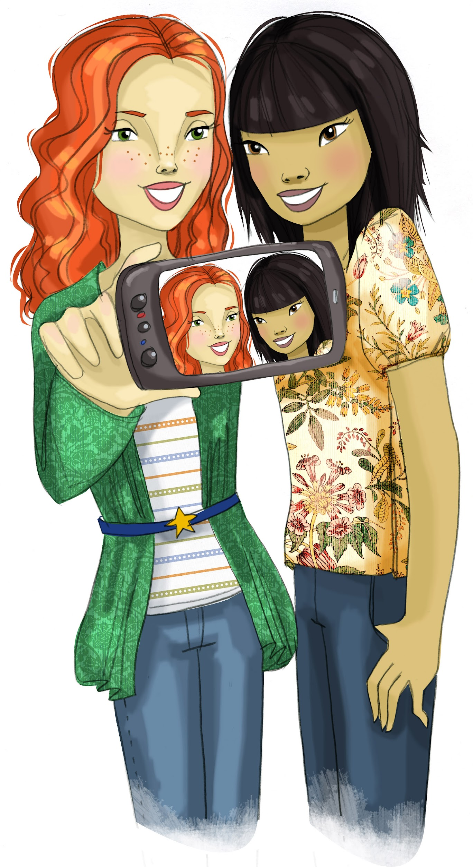
Core Lesson 9: Review and Practice Resistance Techniques
Review where pressures come from to use drugs
What are the good things we get from saying ‘no’ to drugs?

Slide 2
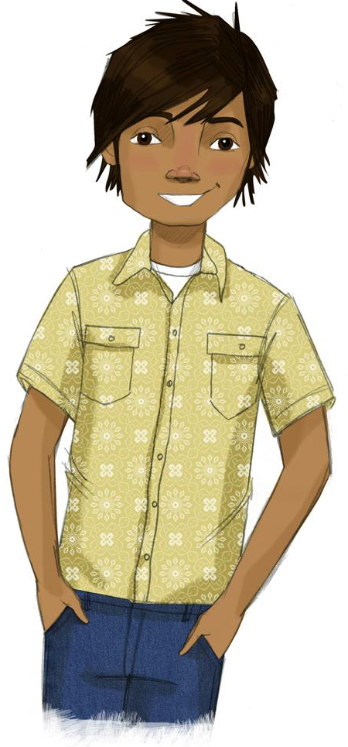
STUDENT GROUND RULES

Slide 3
TEACHER GROUND RULES
RESPECT ALL STUDENTS
I will listen carefully to what you have to say and treat all responses with respect.
INCLUSION
I will encourage all students to participate in the program's activities.
MAINTAIN CONFIDENTIALITY AND PRIVACY
I will keep things I hear in class private unless I learn that a rule, such as getting drunk at school, has been broken. As a teacher, I am required to report this.

Slide 4
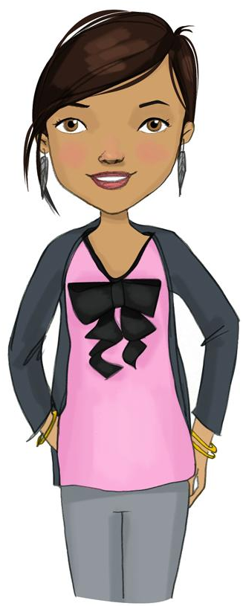
Review: Where Does Pressure to Use Drugs Come From?

Slide 5
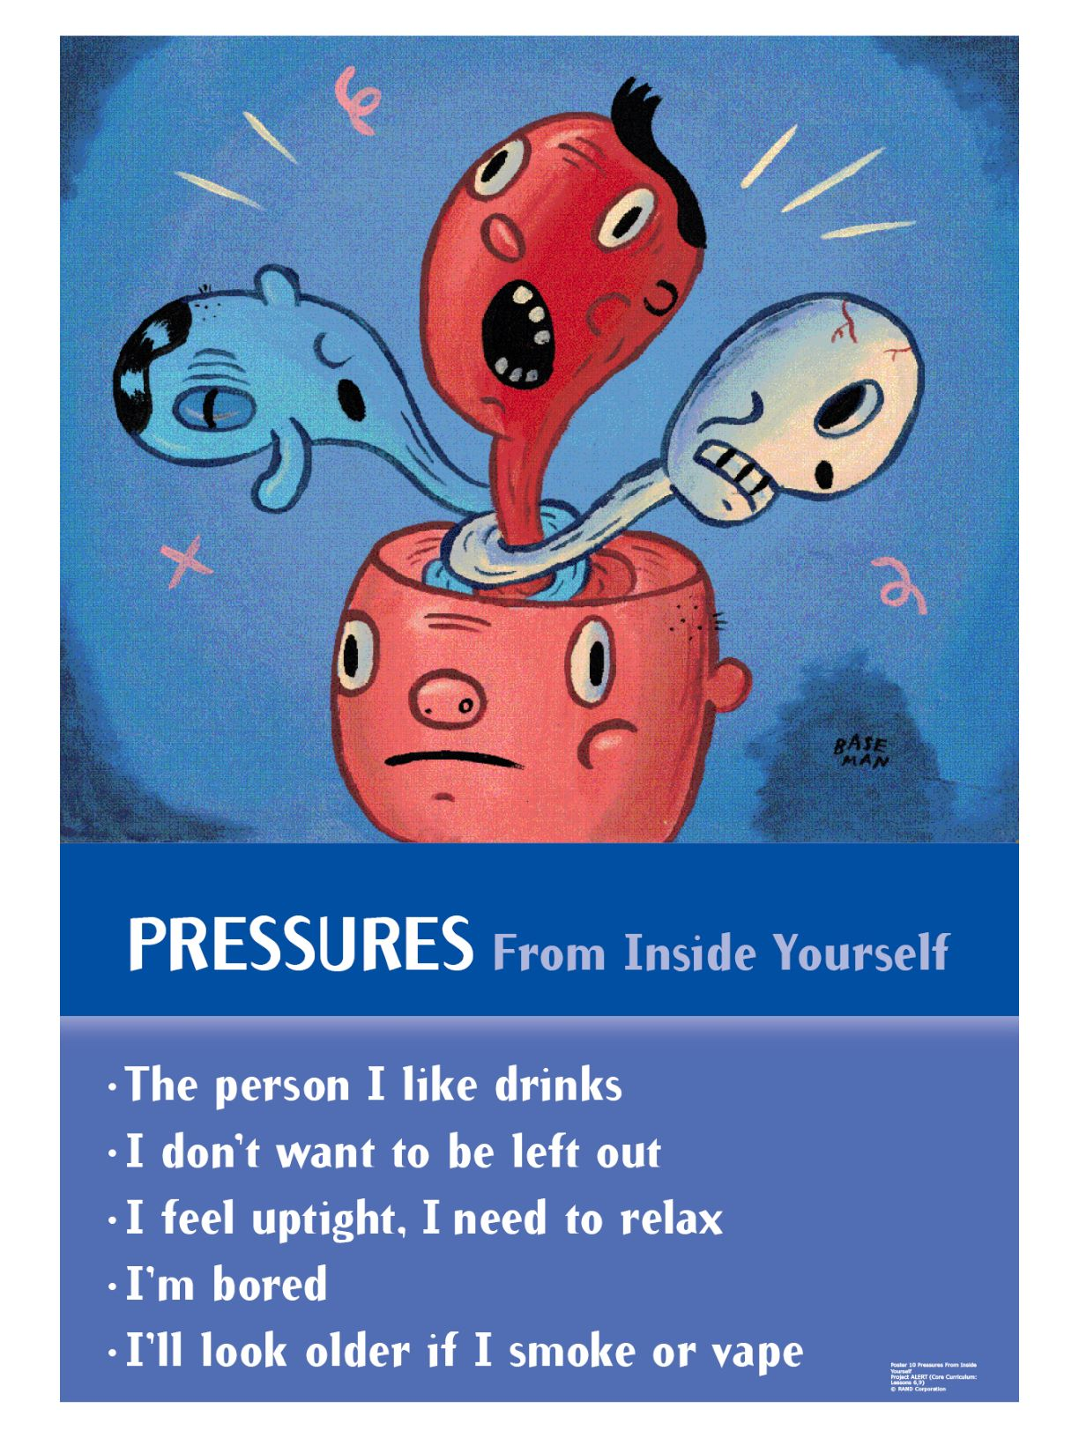
Reviewing Where Pressures Come From

Slide 6
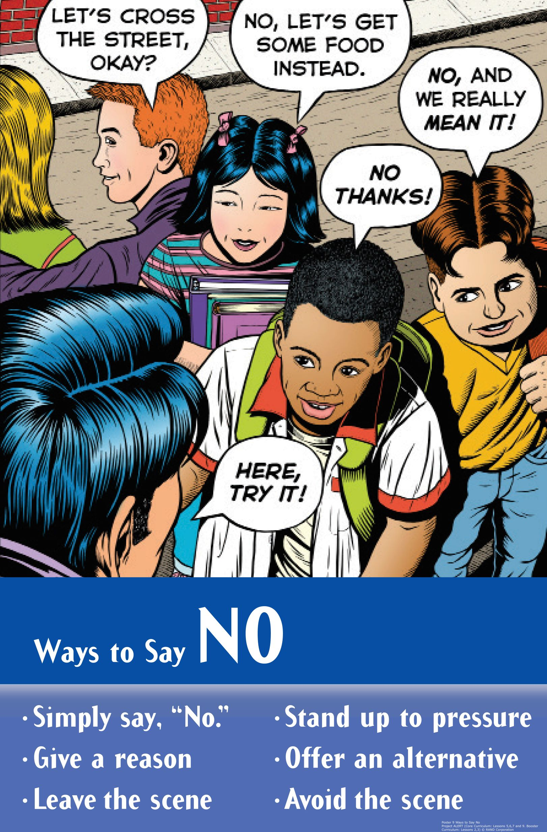
Skits: Resisting Substances
Group Roles:
Director: Assign parts & get group to work together
Actors: Perform the roles of the characters in the skit
Recorder: Write down the final version of the script

Slide 7
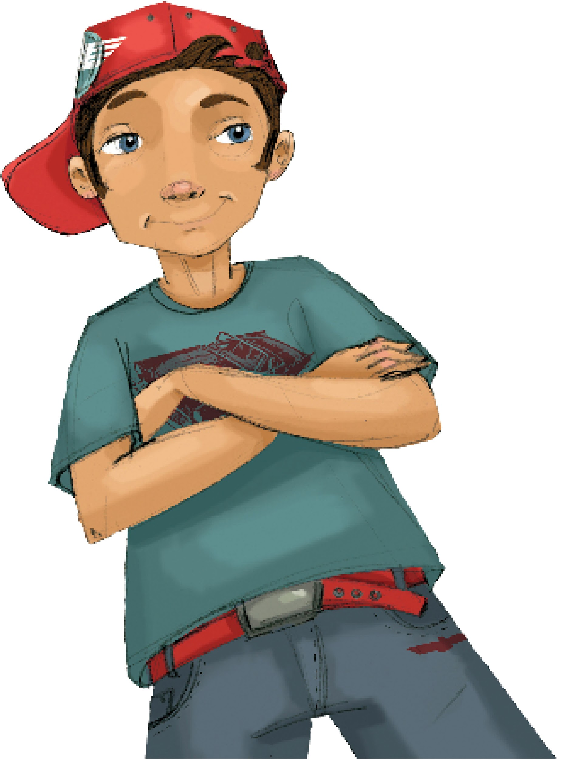
Resisting Skits:
Act Out Skits
Activity Expectations
Speak up
Face the class
Introduce Characters
Attentive Audience

Slide 8
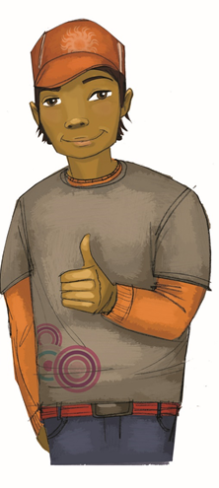
The Benefits Game

Slide 9
Wrap-up
Today We:
Reviewed ways to say "no" to pressure.
Created skits with different approaches to saying "no".
Listed the benefits of saying "no"
Next Lesson We Will:
Learn more ways to say "no"

