Slide 1
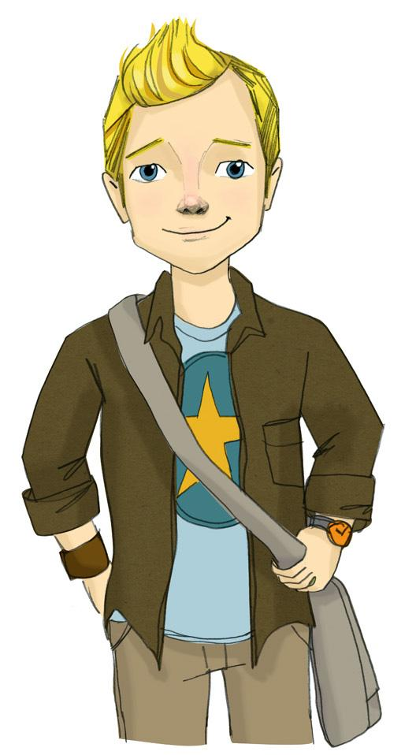
Core Lesson 8: The Safe, Legal Use of Prescription Medications and Risks of Misuse

Slide 2
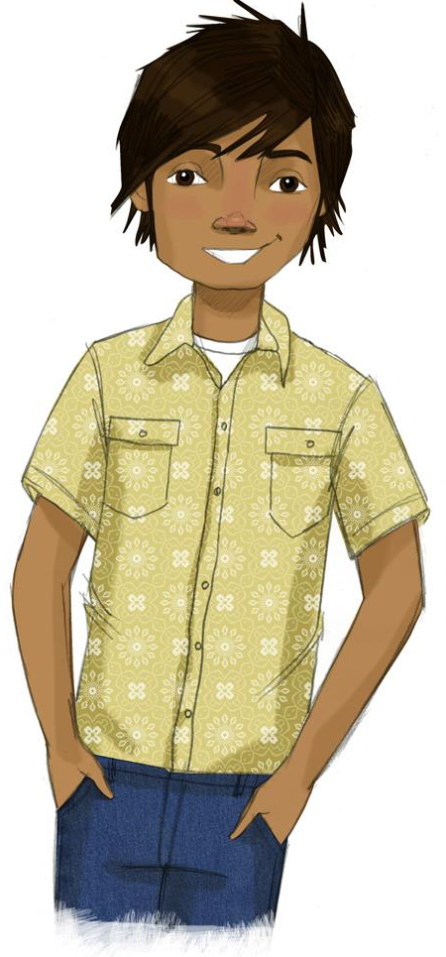
STUDENT GROUND RULES

Slide 3
TEACHER GROUND RULES
RESPECT ALL STUDENTS
I will listen carefully to what you have to say and treat all responses with respect.
INCLUSION
I will encourage all students to participate in the program's activities.
MAINTAIN CONFIDENTIALITY AND PRIVACY
I will keep things I hear in class private unless I learn that a rule, such as getting drunk at school, has been broken. As a teacher, I am required to report this.

Slide 4
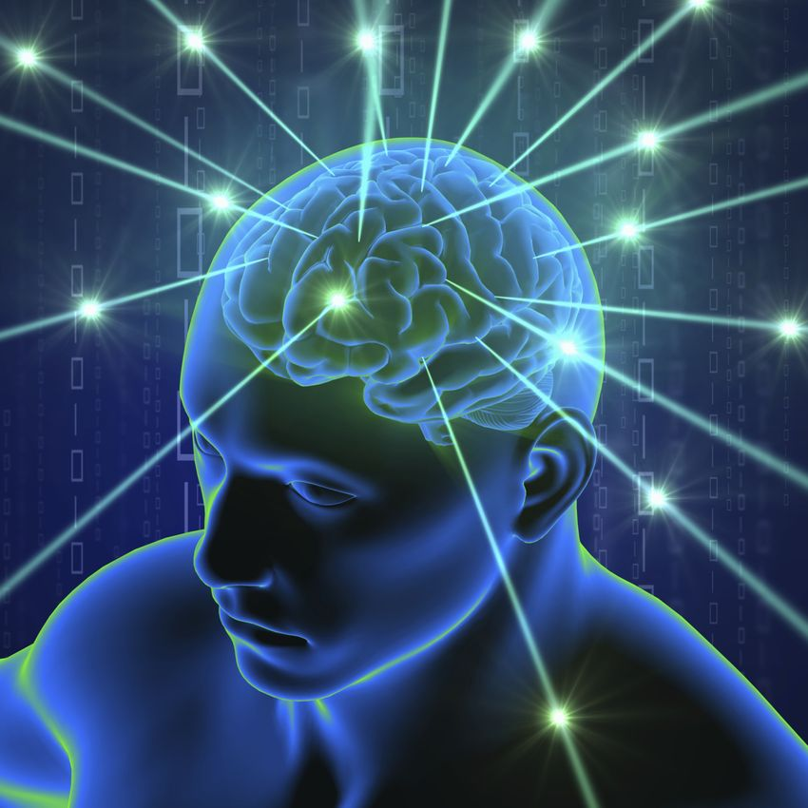
Teen Brain Development and Prescription Medication Safety

Slide 5
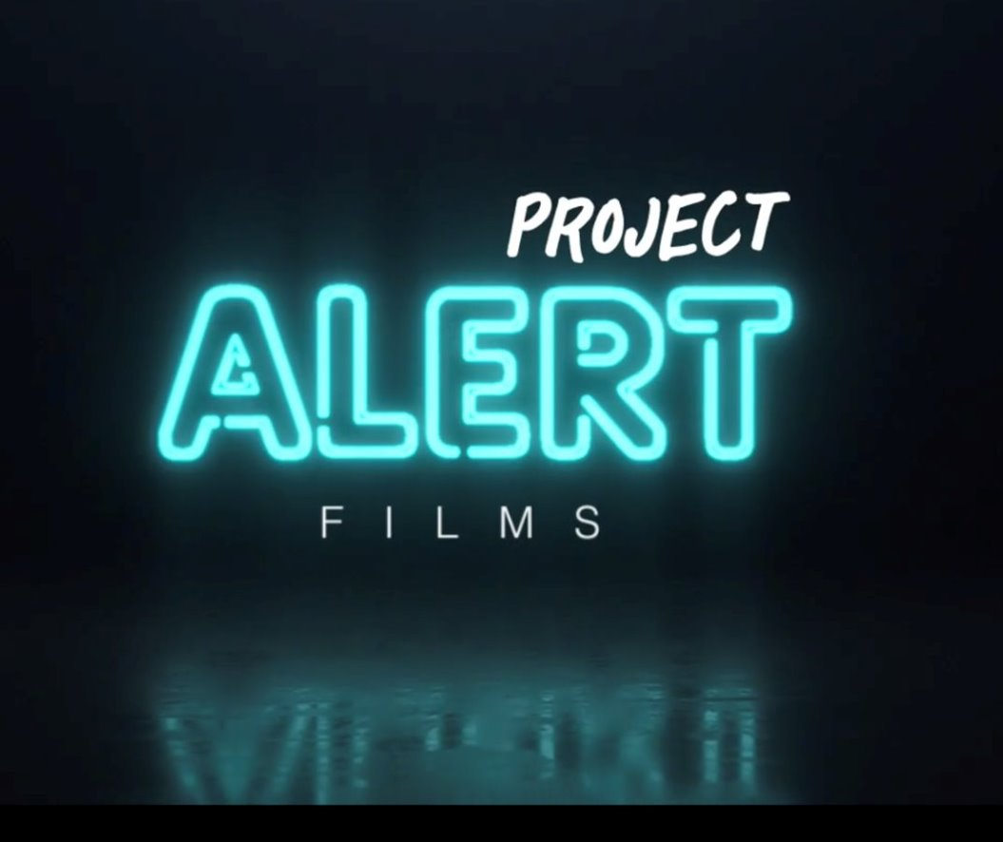
Video: Let’s Talk About Prescription Medication Safety
Notes:
The Videos - https://www.projectalert.com/videos

Slide 6
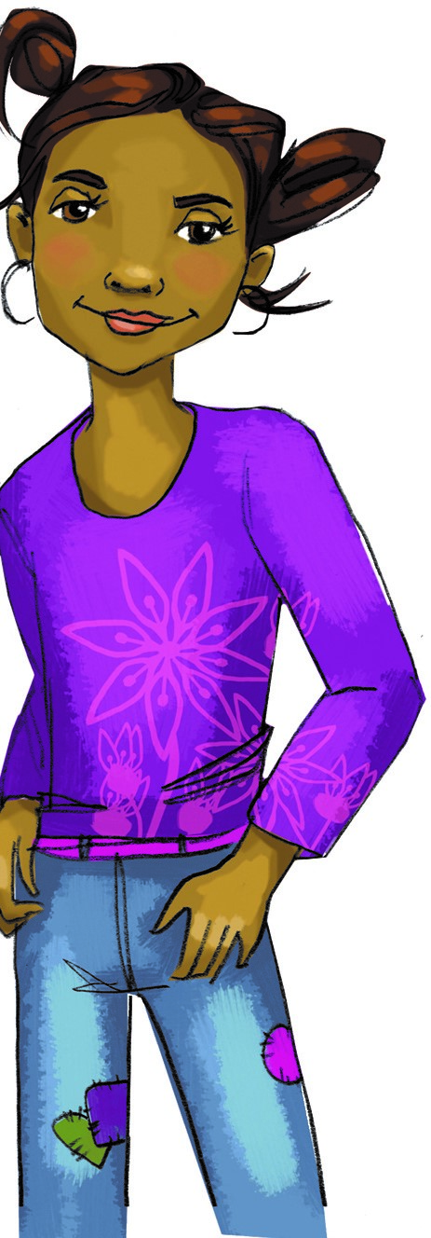
Is Everyone Using These Substances?
Lesson 4 review: In the last 30 days, this is about how many 8th graders...
Used E-cigarettes/Vaped - 9%
Smoked cigarettes - 1%
Used marijuana - 5%
Used alcohol - 6%

Slide 7
Is Everyone Using These Substances?
In the last 30 days, how many teens aged 12-17 do you think...
Misused prescription painkillers
Used heroin

Slide 8
Is Everyone Using These Substances?
In the last 30 days, this is how many teens aged 12-17 actually...
Misused prescription painkillers - less than 3%
Used heroin - less than 1/10th of 1%

Slide 9
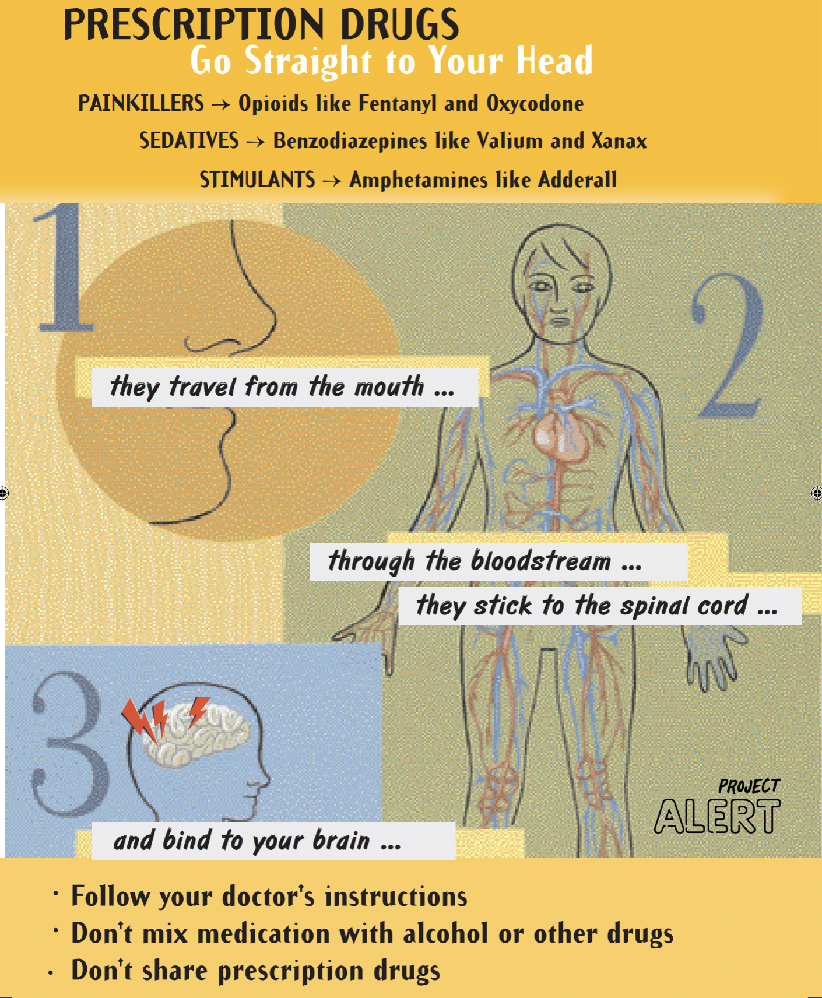
Case Study: Ollie's Injury

Slide 10
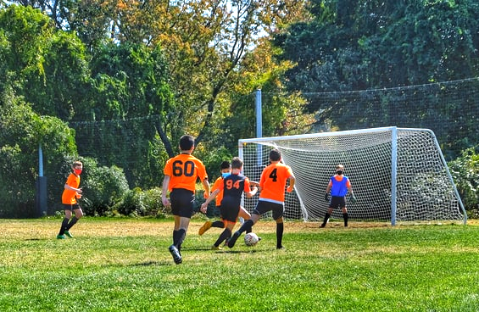
Ollie’s Options
The school’s star soccer player has suffered a severe injury.
Now he has 5 critical decisions to make at 5 different points in his journey.
Help him decide the best way to stay healthy and safe.
Notes:
Photo by Yuval Zukerman on Unsplash

Slide 11
Ollie’s Options: Decision #1
Whether or not to take Vicodin, a prescription painkiller.
What action can Ollie take to help keep him healthy and safe?
Notes:
Photo by Yuval Zukerman on Unsplash

Slide 12
Ollie’s Options: Decision #2
How to cope with feelings of sadness and mild pain?
What action can Ollie take to help keep him healthy and safe?
Notes:
Photo by Yuval Zukerman on Unsplash

Slide 13
Ollie’s Options: Decision #3
Whether or not to take prescription opioids when it's either not necessary or for something it is not prescribed for, like sadness or depression.
What action can Ollie take to help keep him healthy and safe?
Notes:
Photo by Yuval Zukerman on Unsplash

Slide 14
Ollie’s Options: Decision #4
Whether or not to misuse prescription painkillers or to dispose of them.
What action can Ollie take to help keep him healthy and safe?
Notes:
Photo by Yuval Zukerman on Unsplash

Slide 15
Ollie’s Options: Decision #5
Whether or not to use the pills JJ offers.
What action can Ollie take to help keep him healthy and safe?
Notes:
Photo by Yuval Zukerman on Unsplash

Slide 16
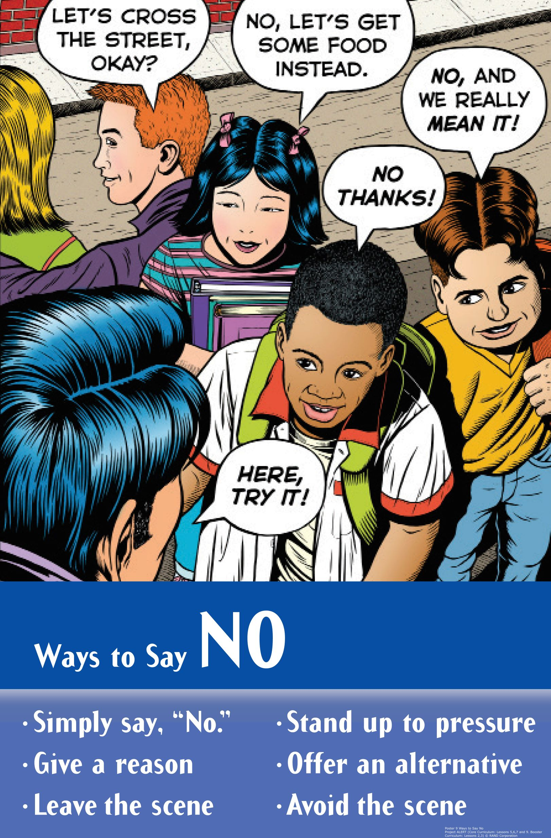
Skits: Reasons Not to Use and Ways to Say No

Slide 17
Wrap-up
Today We:
Learned about safe vs. misuse of prescription drugs
Created skits with different approaches to resisting
Next Lesson We Will:
Learn about the positive things we get from saying " no"

