Slide 1
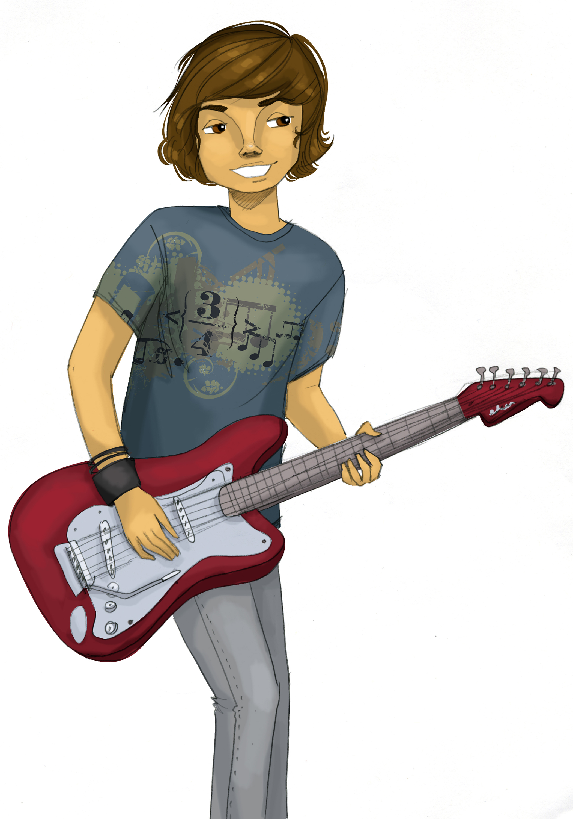
Core Lesson 7: Practicing Resistance Skills
What have we learned so far?

Slide 2
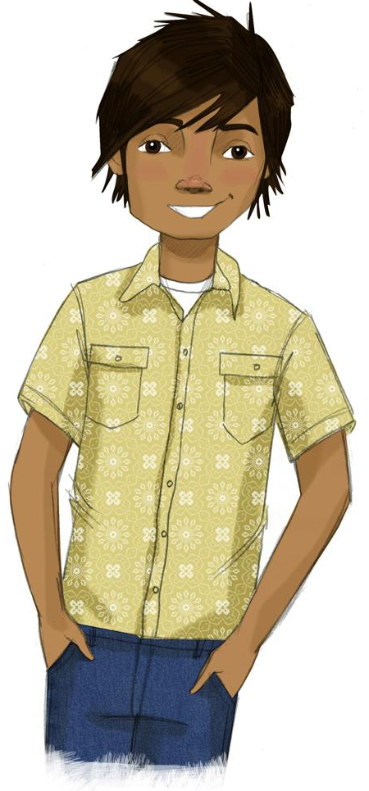
STUDENT GROUND RULES

Slide 3
TEACHER GROUND RULES
RESPECT ALL STUDENTS
I will listen carefully to what you have to say and treat all responses with respect.
INCLUSION
I will encourage all students to participate in the program's activities.
MAINTAIN CONFIDENTIALITY AND PRIVACY
I will keep things I hear in class private unless I learn that a rule, such as getting drunk at school, has been broken. As a teacher, I am required to report this.

Slide 4
Pot or Not?: The Problem
Notes:
The Videos - https://www.projectalert.com/videos

Slide 5
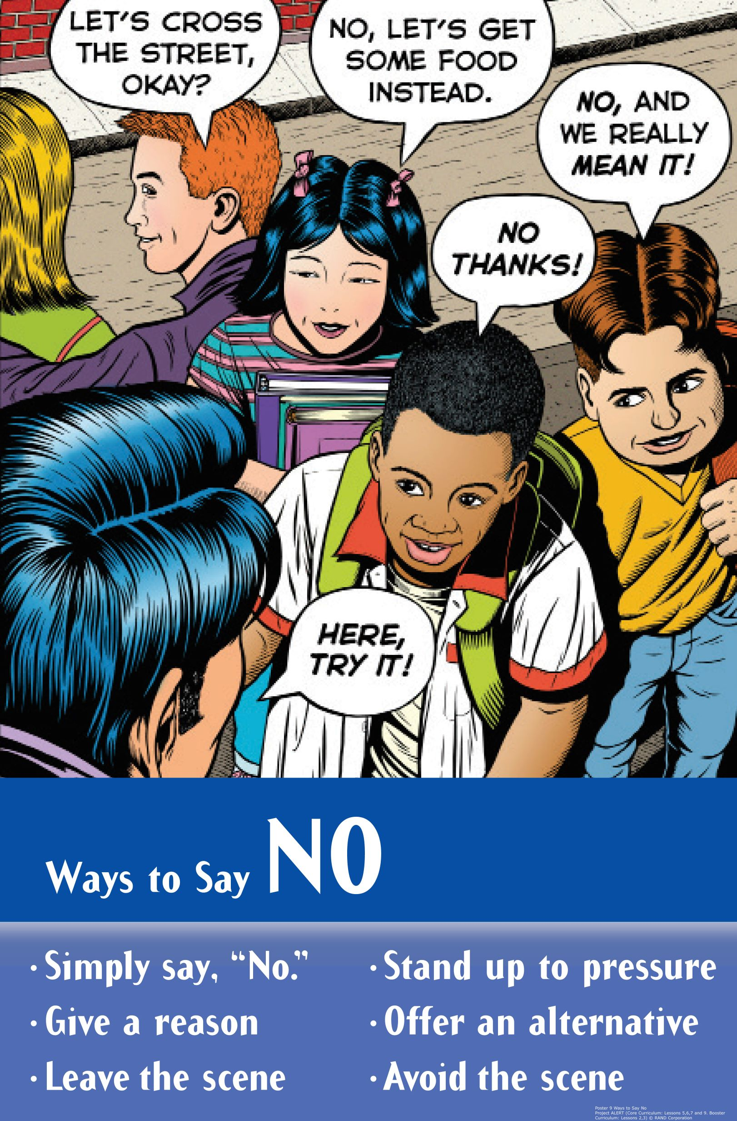
Skits: One Way Tom Can Say “No”
Group Roles:
Director: Assign parts & get group to work together
Actors: Perform the roles of the characters in the skit
Recorder: Write down the final version of the script

Slide 6
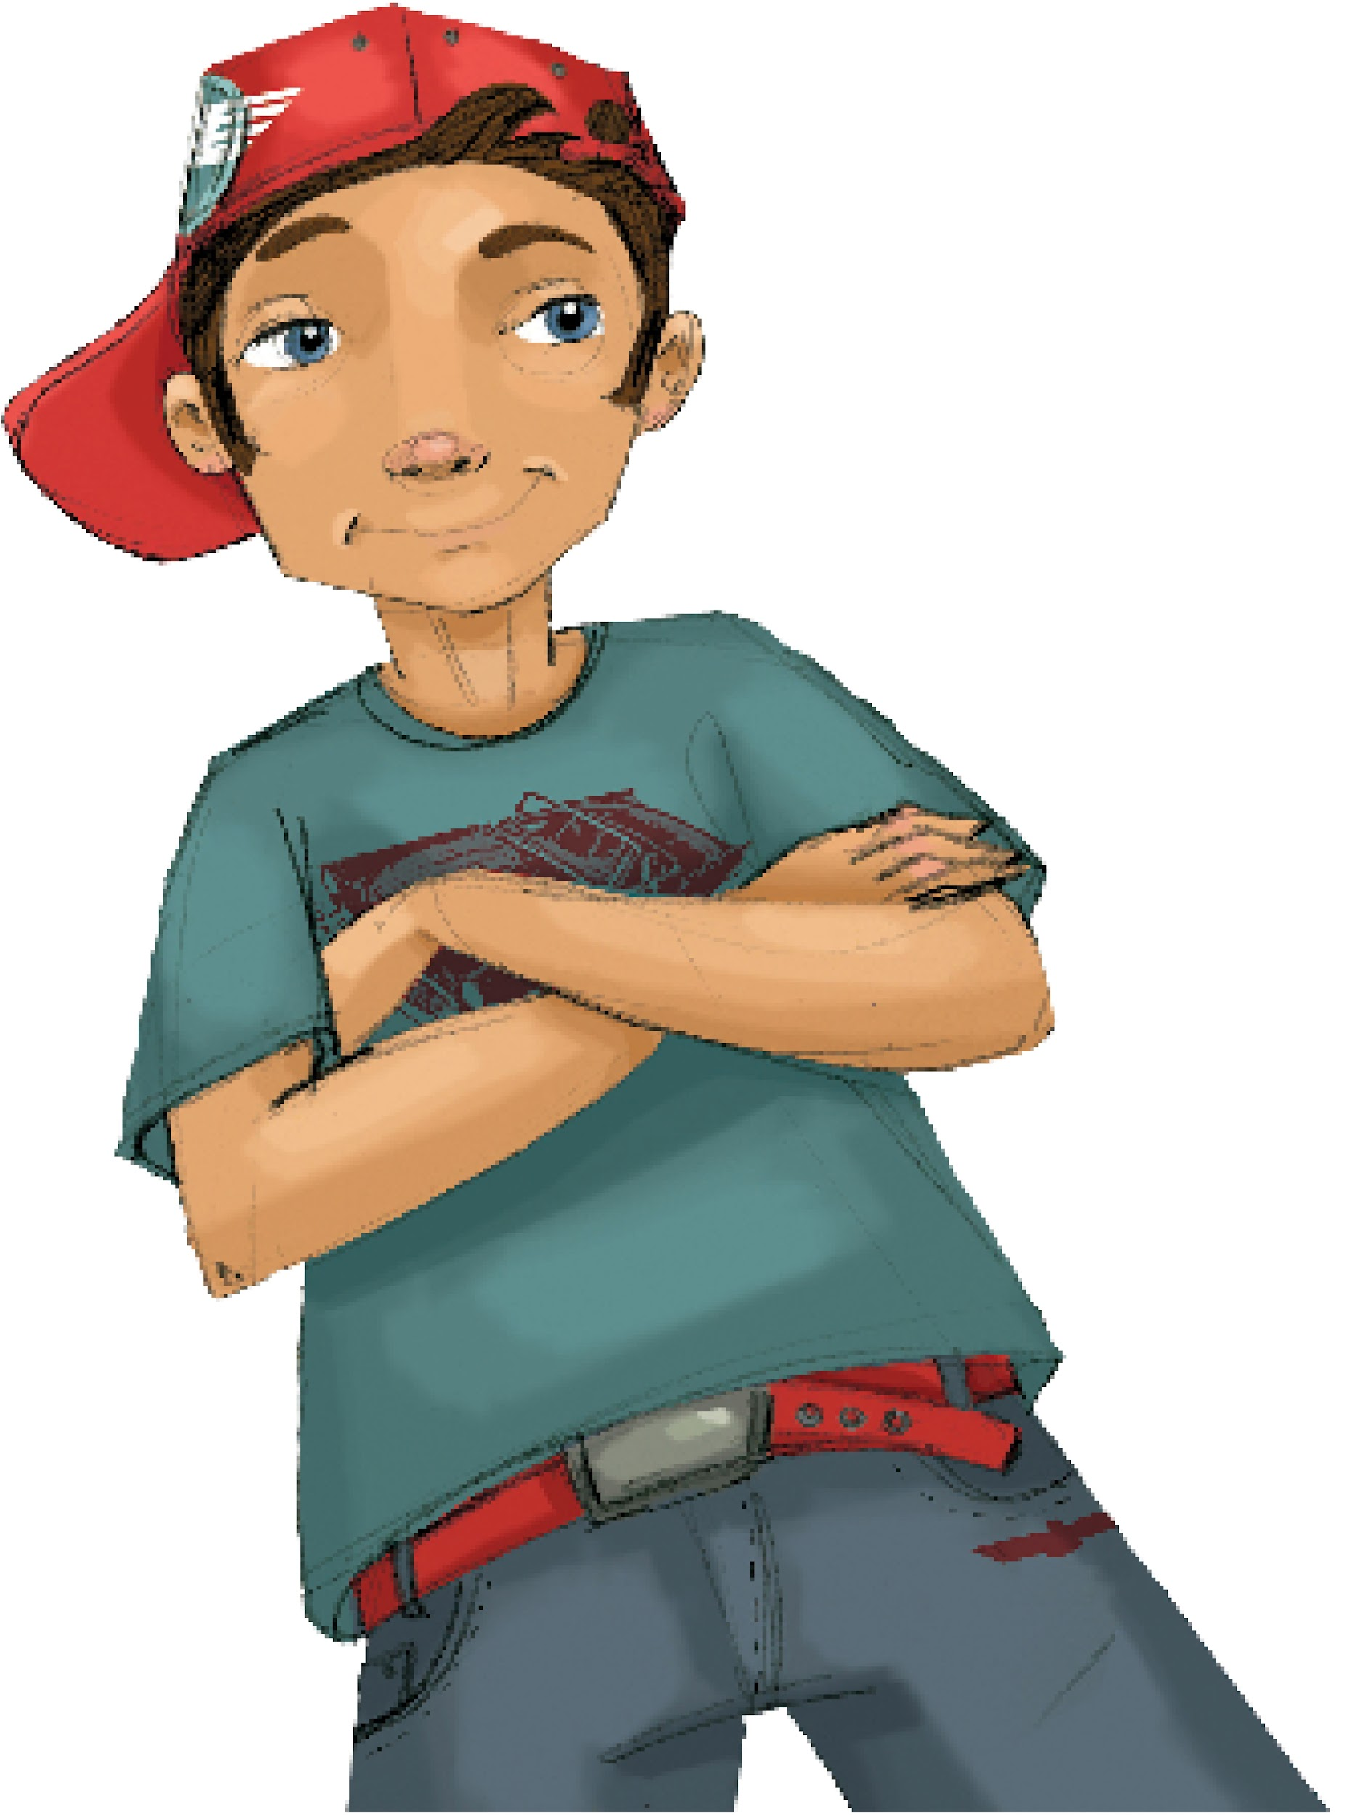
Pot or Not:
Act Out Skits
Activity Expectations
Speak up
Face the class
Introduce Characters
Attentive Audience

Slide 7
Pot or Not?: Solutions
Notes:
The Videos - https://www.projectalert.com/videos

Slide 8
Wrap-up
Today We:
Talked about ways to say "no" to pressure.
Created skits with different approaches to saying "no".
Next Lesson We Will:
Learn about the risks of misusing prescription medications

