Slide 1
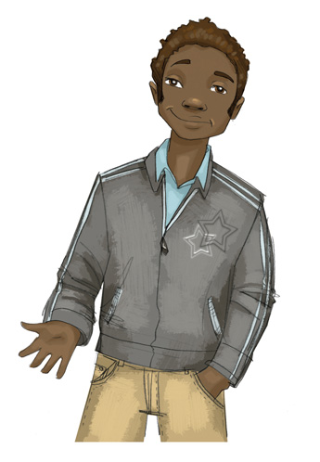
Core Lesson 6: Resisting Internal and External Pressures to Use Drugs
How can we respond to social and internal pressures to use substances?
What are some good ways to say “no” when we’re offered substances?

Slide 2
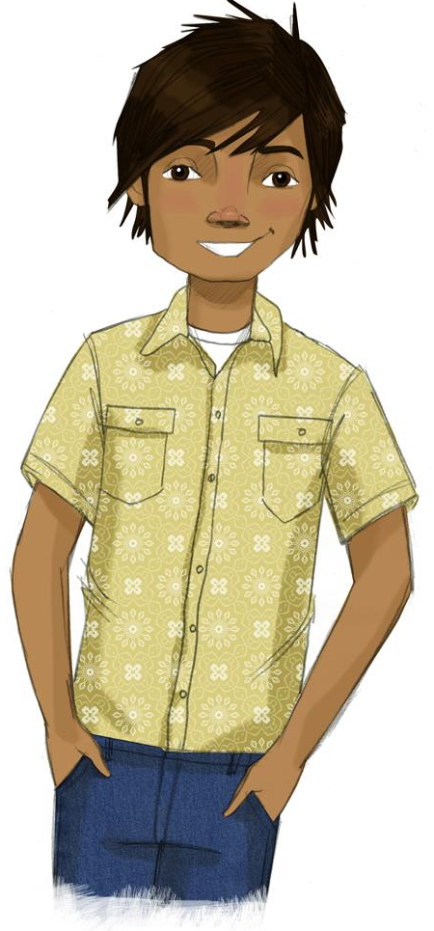
STUDENT GROUND RULES

Slide 3
TEACHER GROUND RULES
RESPECT ALL STUDENTS
I will listen carefully to what you have to say and treat all responses with respect.
INCLUSION
I will encourage all students to participate in the program's activities.
MAINTAIN CONFIDENTIALITY AND PRIVACY
I will keep things I hear in class private unless I learn that a rule, such as getting drunk at school, has been broken. As a teacher, I am required to report this.

Slide 4
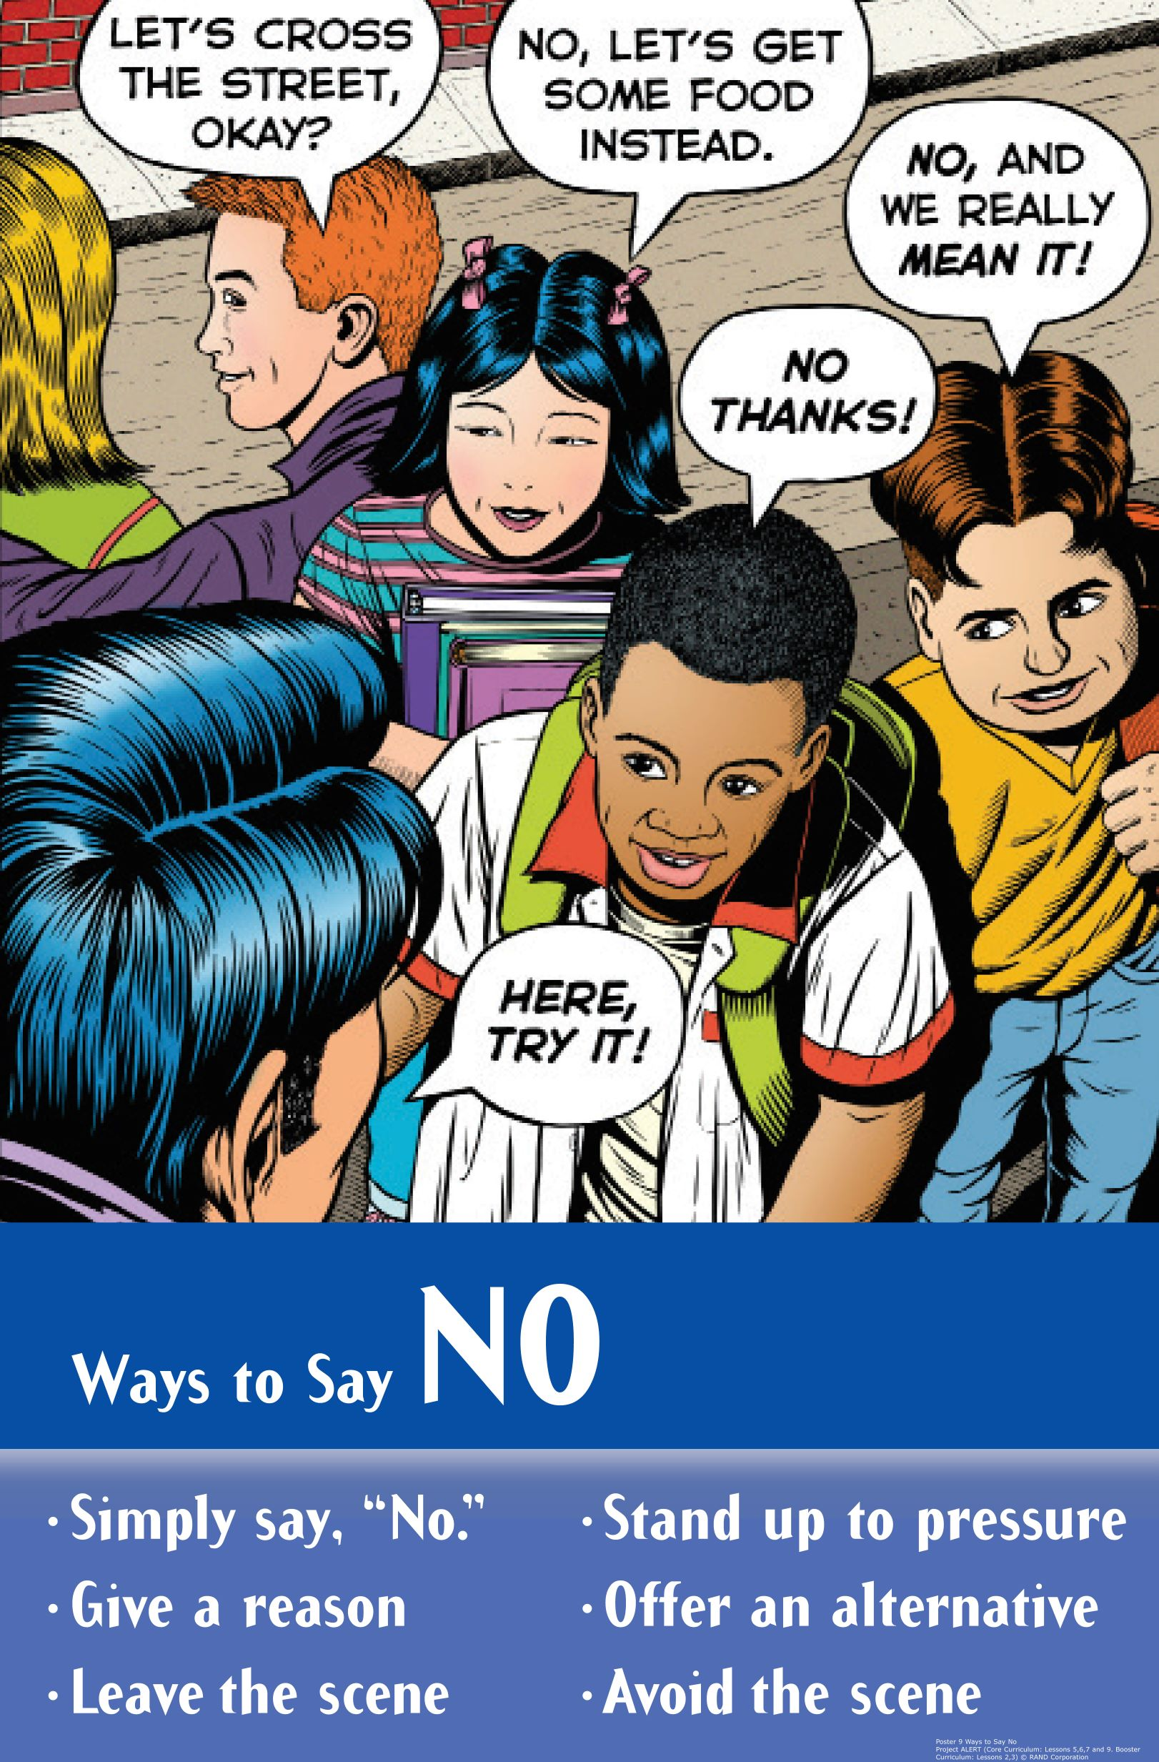
Saying “No” to External Pressures

Slide 5
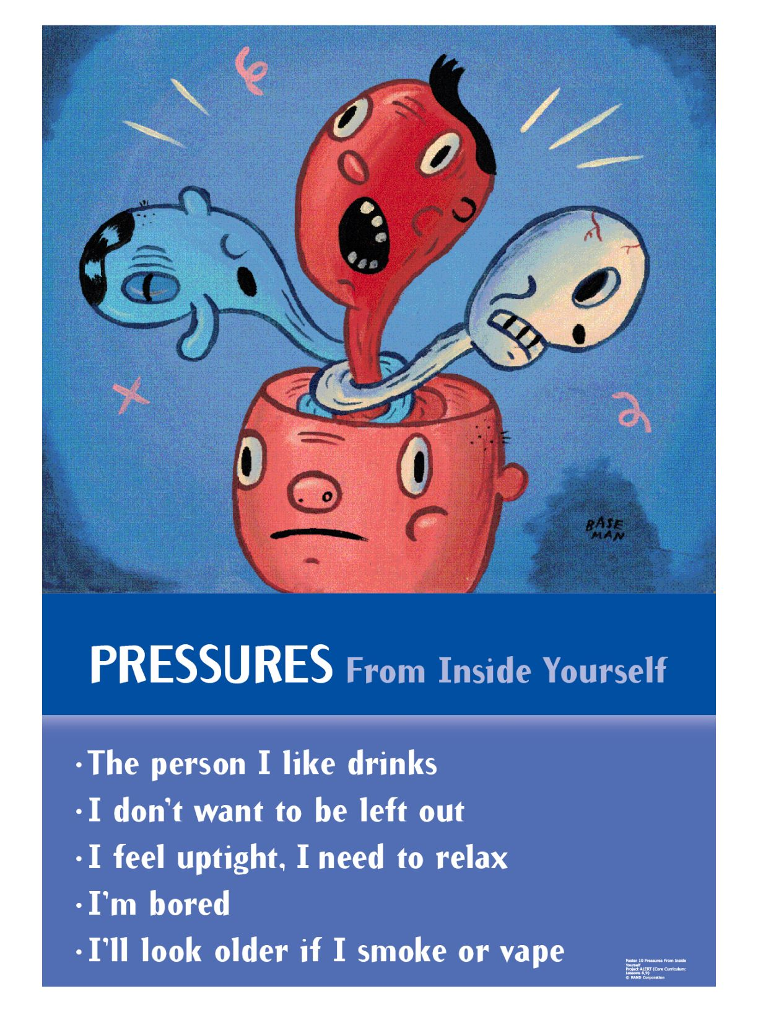
Ways to Say “No” to Internal Pressure

Slide 6
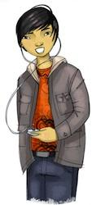
Pressure Scenarios

Slide 7
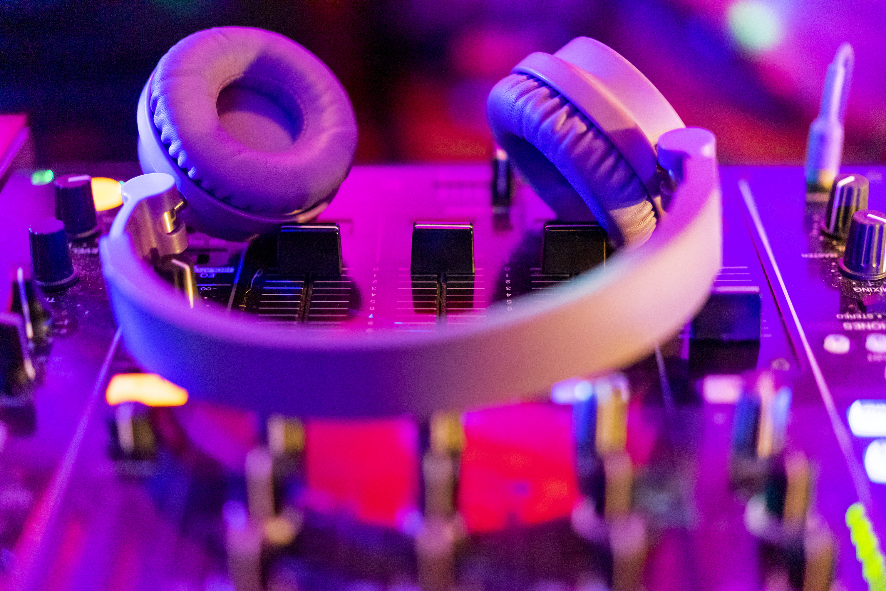
Alcohol-Party
It’s Friday night. You and your friends are planning to go to the movies. When you get to your best friend’s house, the group has already decided to skip the movies and have a party instead.
Someone has brought beer, and several people are drinking. No one pressures you to drink or even offers you anything, but you feel like maybe you should drink.
What could you do, say, or think so that you would not drink?

Slide 8
Marijuana-Alone and Bored
It’s Saturday afternoon, and you’re alone with nothing to do. Suddenly, you remember that your older brother, who is away at college, left a stash of marijuana in his room.
You think, “Getting high will certainly make the afternoon less boring.”
What could you do, say, or think so that you won’t use marijuana edibles ?

Slide 9
Vaping-Older Teens
You are at home alone with your older sister. There’s a knock at the door. You open it and find two of her friends standing there.
They come in and start talking to your sister. You want to be included but feel left out. One of them pulls out an e-cigarette and lights up. No one offers you a hit. You think, “Maybe if I vaped, they would include me in their conversation.”
What could you do, say, or think so that you wouldn’t feel like you had to vape to be included?

Slide 10
Alcohol- Fight with Parents
It’s Friday night, and there’s a great party about to happen. You just had a fight with your parents. They have given you a really early curfew, and they won’t let you stay out even an extra half hour. You are really angry! When you get to the party, you think, “Maybe I’ll just get wasted and show them.” No one pressures you to drink, but you are angry and hurt and you think, “Getting wasted might make things better.”
What could you do, say, or think so that you would not drink?

Slide 11
Internal Pressure Scenarios (D1)
It’s Friday night, and there’s a great party about to happen. You just had a fight with your parents. They have given you a really early curfew, and they won’t let you stay out even an extra half hour. You are really angry!
When you get to the party, you think, “Maybe I’ll just get wasted and show them.” No one pressures you to drink, but you are angry and hurt and you think, “Getting wasted might make things better.”
What could you do, say, or think so that you would not drink?

Slide 12
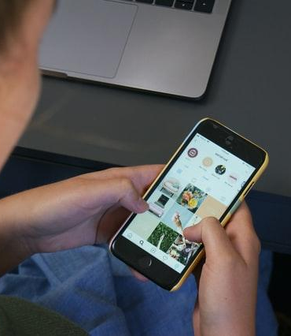
Vaping- Friends posting pictures on social media
You are online and see that friends are posting pictures and some are vaping.
You think to yourself, “Should I respond? Should I like, ignore, or comment on their posts?”
What could you do, say, or think in order not to feel like you have to show approval of your friends vaping?

Slide 13
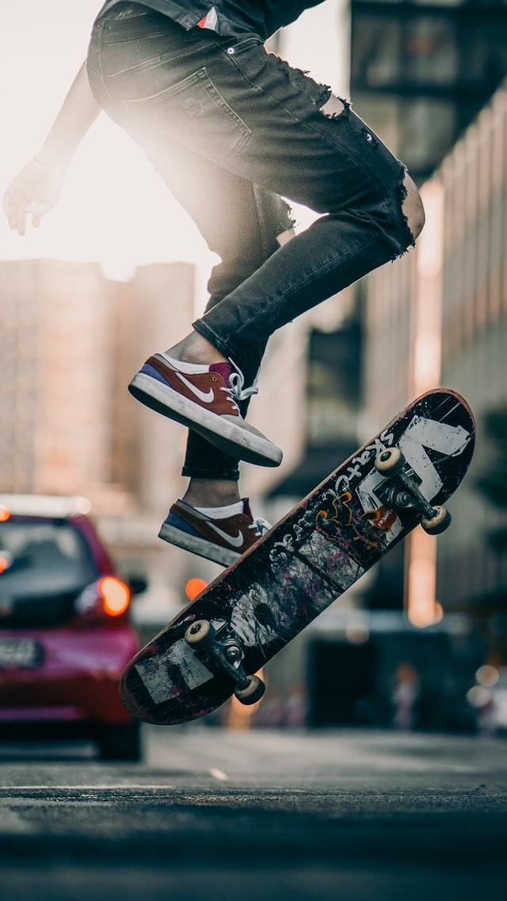
Other Pressures
What other pressures do teens feel besides pressures to smoke, vape, drink, and use drugs?

Slide 14
Wrap-up
Today We:
Recognized pressures from others and yourself
Practiced ways to say "no"
Next Lesson We Will:
Continue practicing our resistance skills

