Slide 1
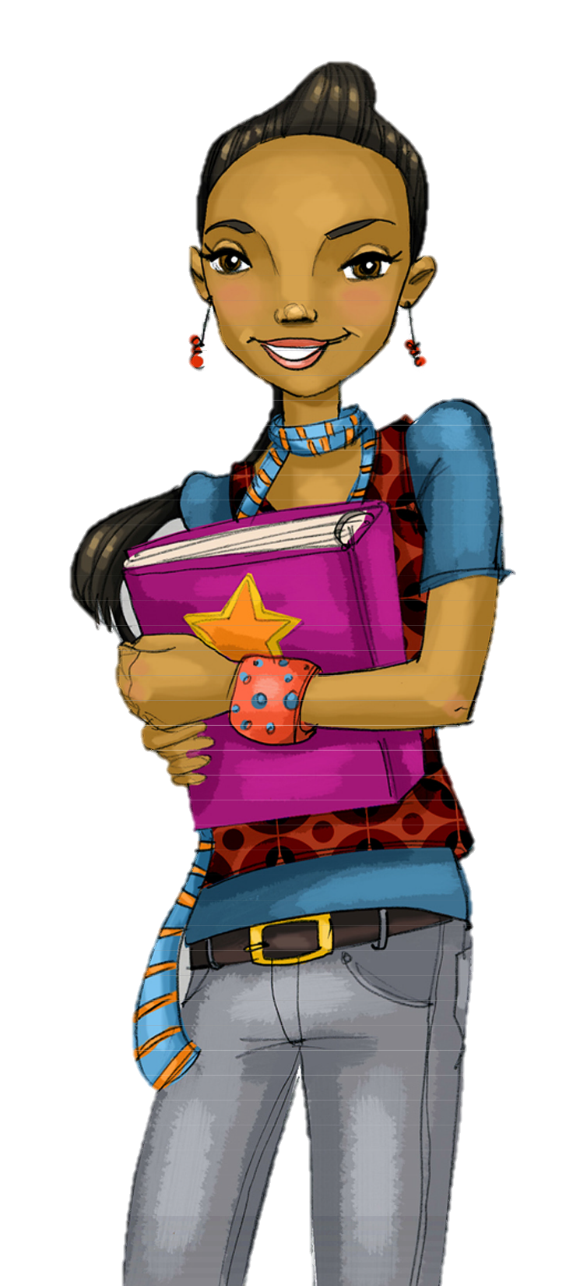
Core Lesson 5:
Social Pressures to Use Drugs
How can we identify pressures to use substances?
What are some good ways to say “No” when we’re offered substances?

Slide 2
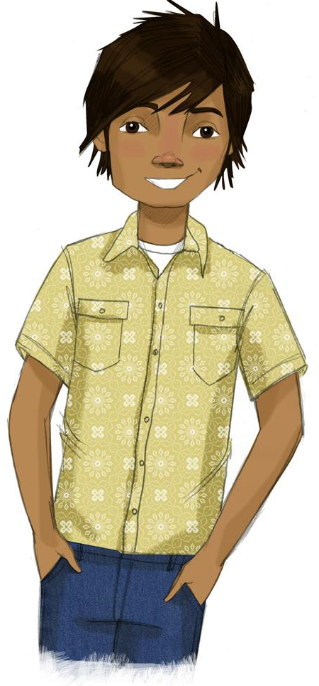
STUDENT GROUND RULES

Slide 3
TEACHER GROUND RULES
RESPECT ALL STUDENTS
I will listen carefully to what you have to say and treat all responses with respect.
INCLUSION
I will encourage all students to participate in the program's activities.
MAINTAIN CONFIDENTIALITY AND PRIVACY
I will keep things I hear in class private unless I learn that a rule, such as getting drunk at school, has been broken. As a teacher, I am required to report this.

Slide 4
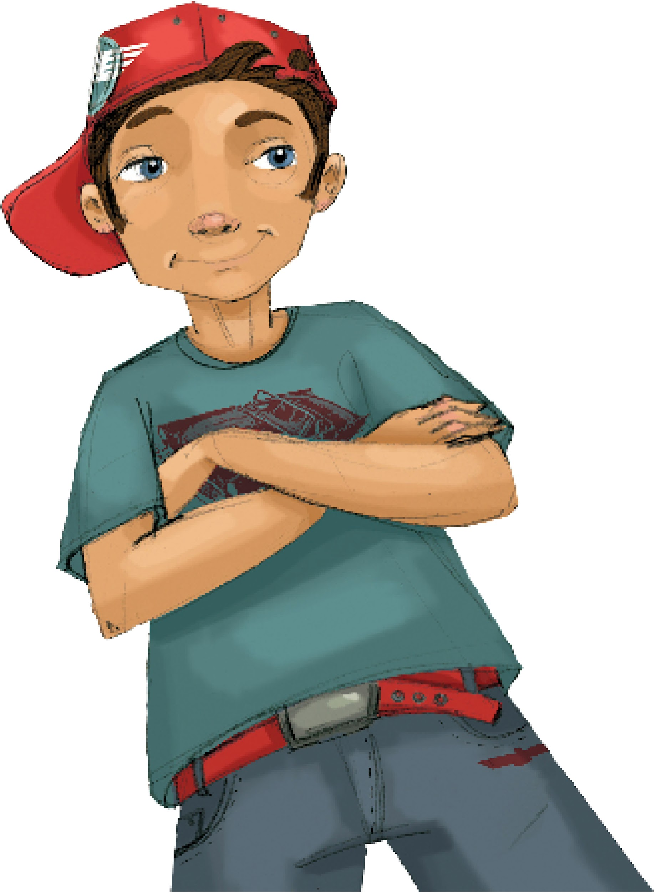
Lindsey’s Choice: The Problem
Notes:
2. Show Partial Video: Lindsey’s Choice (Problem) (7 min.)
https://www.projectalert.com/videos

Slide 5
Lindsey’s Choice: Cast of Characters
Lindsey, girl with a decision to make
Frank, the person making the offer to use

Slide 6
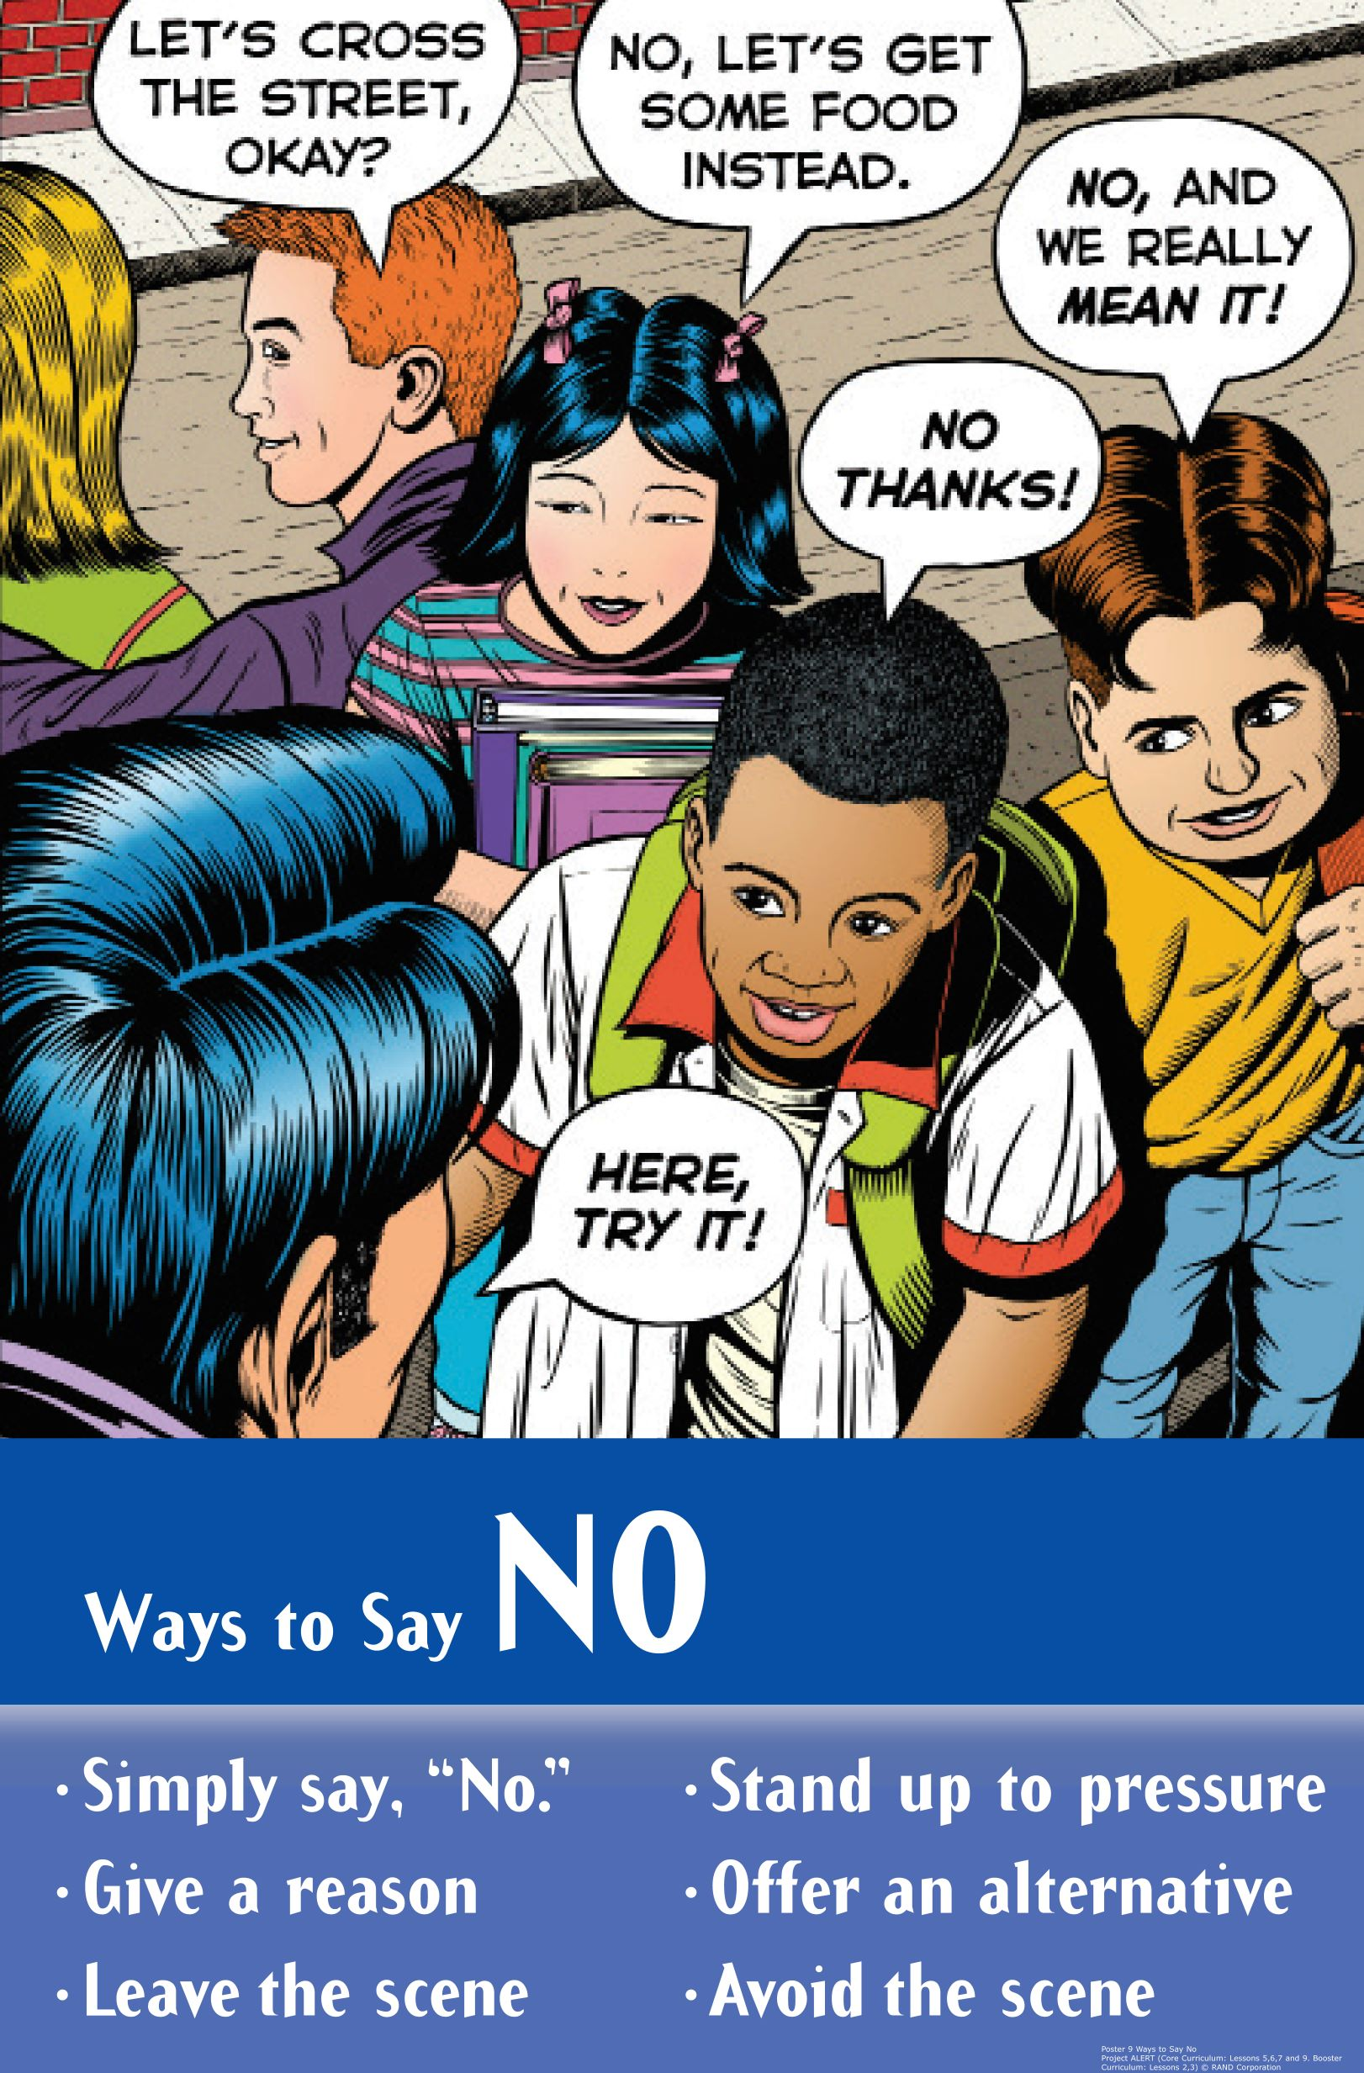
Skits: One Way Lindsey Can Say “No”
Group Roles:
Director: Assign parts & get group to work together
Actors: Perform the roles of the characters in the skit
Recorder: Write down the final version of the script

Slide 7
Lindsey’s Choice:
Act Out Skits
Activity Expectations
Speak up
Face the class
Introduce Characters
Attentive Audience

Slide 8
Lindsey’s Choice: Solutions
Notes:
5. Show Rest of Video: Lindsey’s Choice (Solutions) (2 min.)
https://www.projectalert.com/videos

Slide 9
Wrap-up
Today We:
Talked about ways to say "no" to pressure
Created skits with different approaches to saying "no"
Next Lesson We Will:
Learn more ways to say "no"

