Slide 1
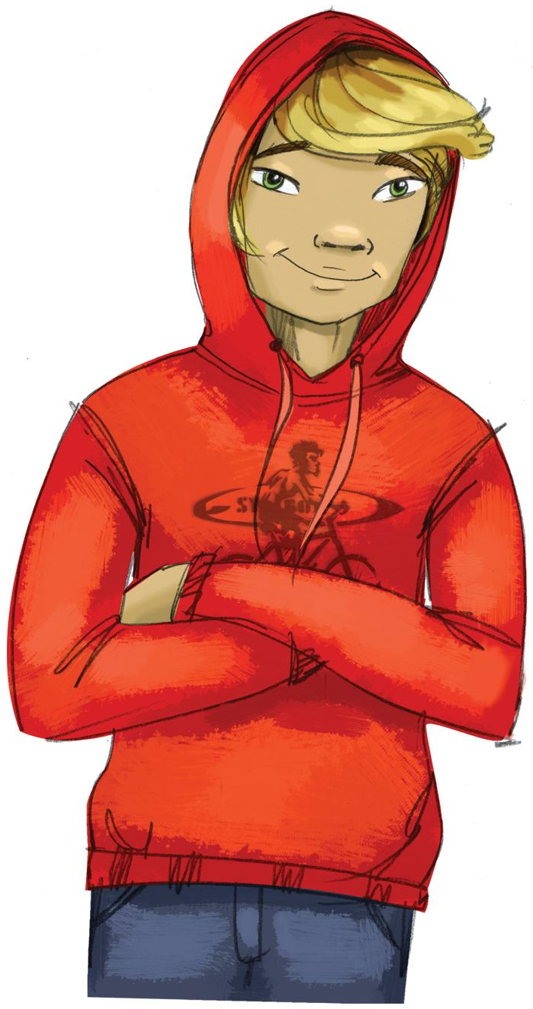
Lesson 4:
Introduction to Pressures
Where do pressures to use substances come from?
How many youth are actually using drugs?
How does advertising pressure us to use substances?

Slide 2
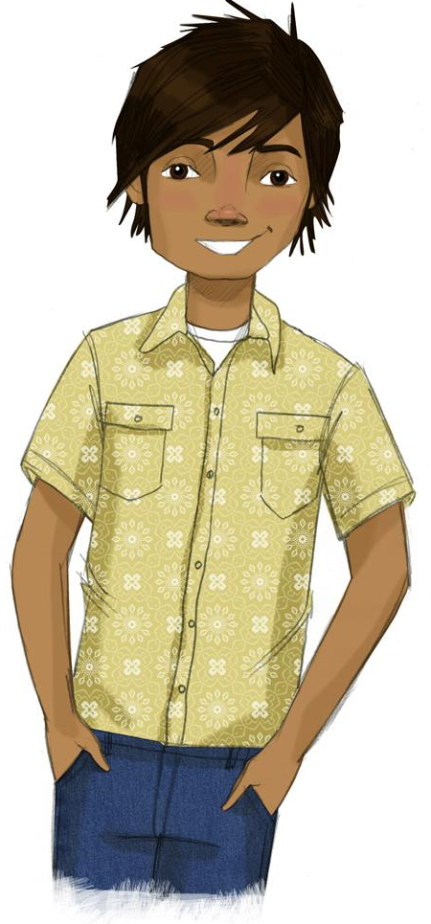
STUDENT GROUND RULES

Slide 3
TEACHER GROUND RULES
RESPECT ALL STUDENTS
I will listen carefully to what you have to say and treat all responses with respect.
INCLUSION
I will encourage all students to participate in the program's activities.
MAINTAIN CONFIDENTIALITY AND PRIVACY
I will keep things I hear in class private unless I learn that a rule, such as getting drunk at school, has been broken. As a teacher, I am required to report this.

Slide 4
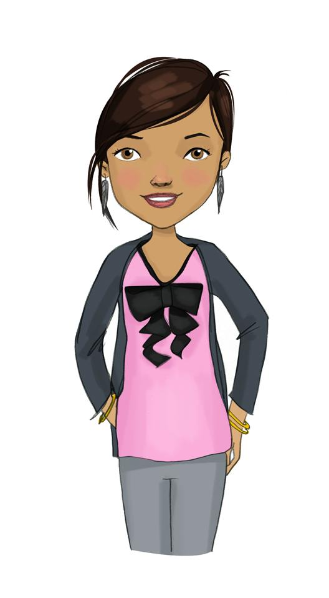
Where Does Pressure to Use Drugs Come From?
WHERE DO PRESSURES COME FROM? | WHAT MIGHT THEY SAY?

Slide 5
Substance Use Estimates: Past Month
(Percentage of 8th graders in the United States)
Percentage | % that did | % that did not
Used nicotine vape or e-cig
Smoked cigarettes
Used marijuana
Used alcohol

Slide 6
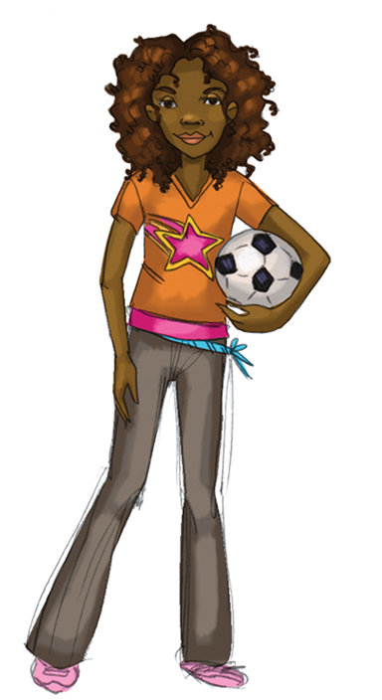
What Part Do Marketing, Advertising, and Social Media Play?
WHERE DO PRESSURES COME FROM?​ | WHAT MIGHT THEY SAY?​
​ | ​

Slide 7
What is this ad trying to make us believe about this product?

Slide 8
What is this ad trying to make us believe about this product?

Slide 9
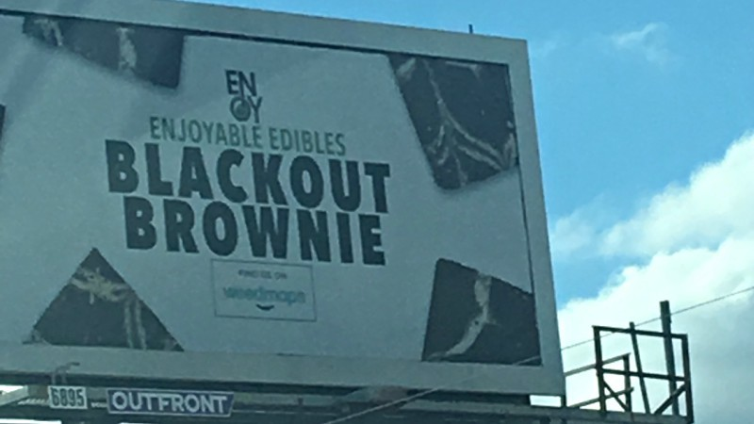
What is this ad trying to make us believe about this product?

Slide 10
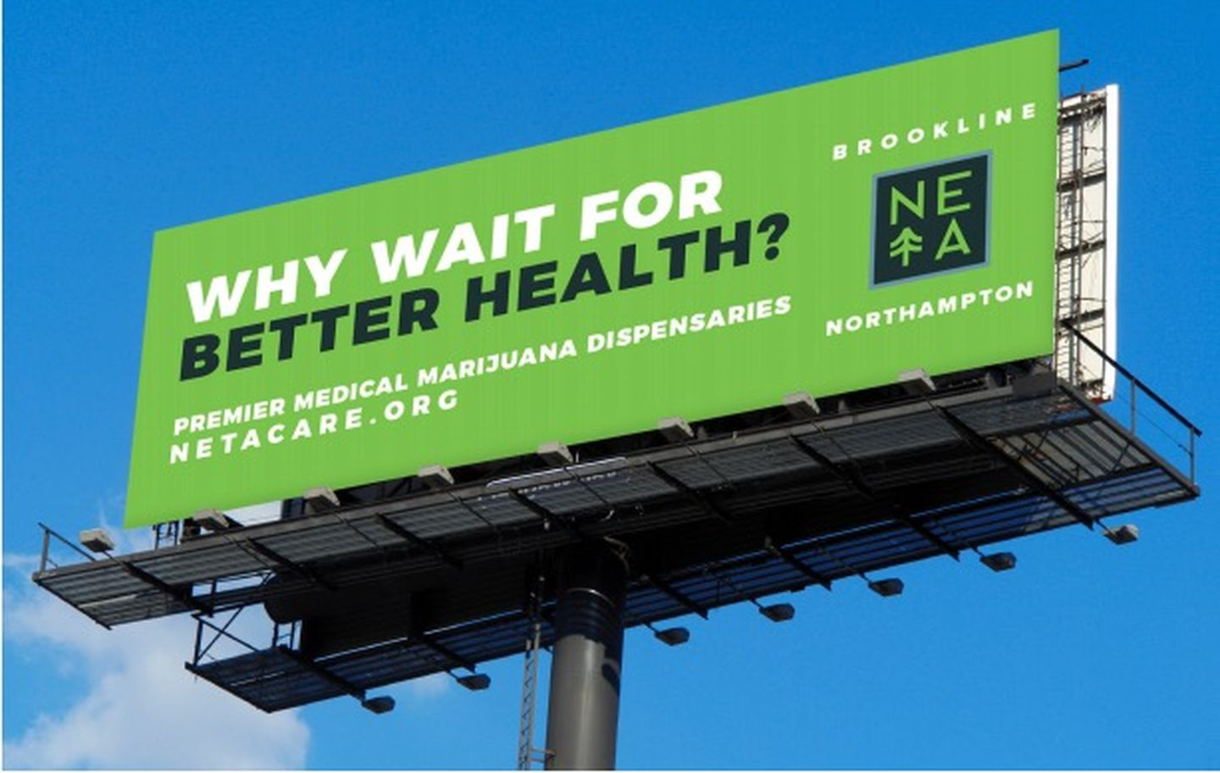
What is this ad trying to make us believe about this product?

Slide 11
What is this ad trying to make us believe about this product?

Slide 12
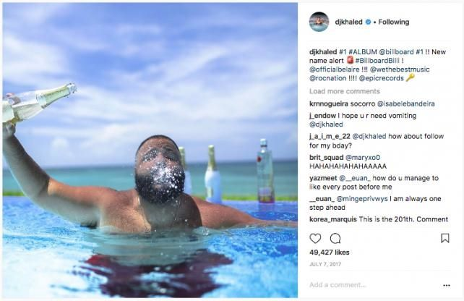
What is this social media post trying to make us believe about this product?

Slide 13
Rewriting Substance Ads: Saying What They Really Mean

Slide 14
How could we rewrite this ad so that it says what is really true?

Slide 15
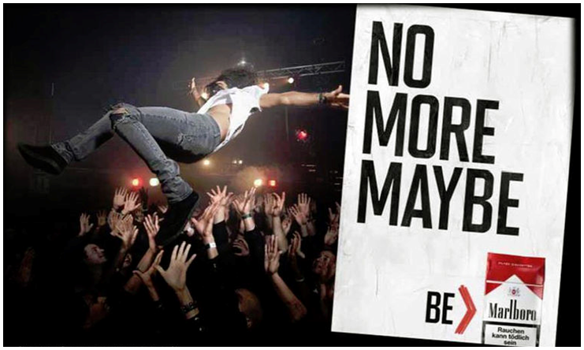
How could we rewrite this ad so that it says what is really true?

Slide 16
How could we rewrite this ad so that it says what is really true?

Slide 17
How could we rewrite this ad so that it says what is really true?

Slide 18
Wrap-up
Today We:
Learned about internal and external pressures to use substances
Thought about how advertising can try to influence someone to use drugs
Next Lesson We Will:
Learn about how to resist pressures from our friends and peers

