Slide 1
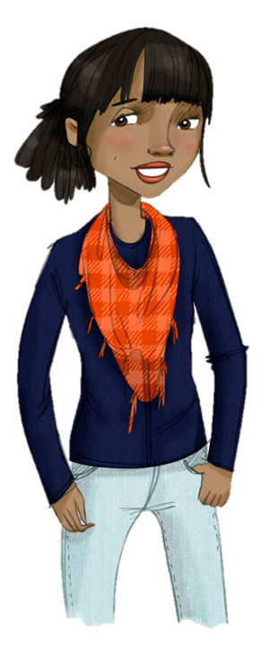
Lesson 3:
Consequences of Drinking
Why people drink?
What happens to you when you drink?
Review facts about alcohol

Slide 2
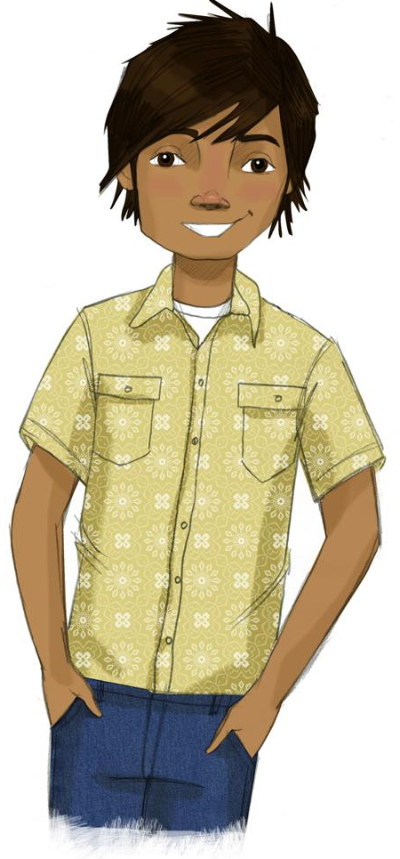
STUDENT GROUND RULES

Slide 3
TEACHER GROUND RULES
RESPECT ALL STUDENTS
I will listen carefully to what you have to say and treat all responses with respect.
INCLUSION
I will encourage all students to participate in the program's activities.
MAINTAIN CONFIDENTIALITY AND PRIVACY
I will keep things I hear in class private unless I learn that a rule, such as getting drunk at school, has been broken. As a teacher, I am required to report this.

Slide 4
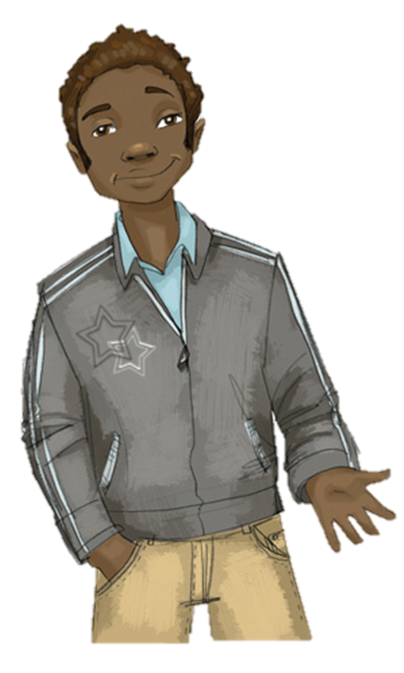
Reasons Why People Use Marijuana ?

Slide 5
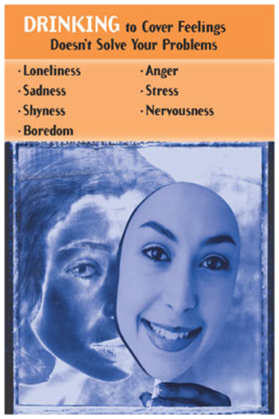
Using Alcohol to Cover Up Feelings

Slide 6
What Happens When People Drink?
Any time | Regularly or a few drinks a week | Heavily or a lot at one time

Slide 7
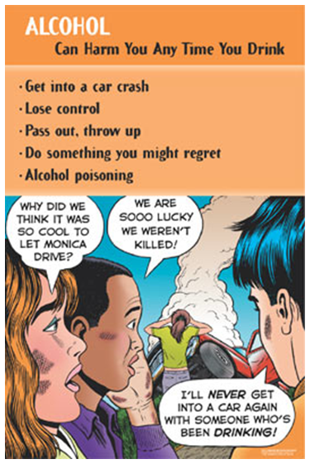
What Happens When People Drink?
Any Time

Slide 8
What Happens When People Drink?
Any time | Regularly or a few drinks a week | Heavily or a lot at one time

Slide 9
What Happens When People Drink?
Any time | Regularly or a few drinks a week | Heavily or a lot at one time

Slide 10
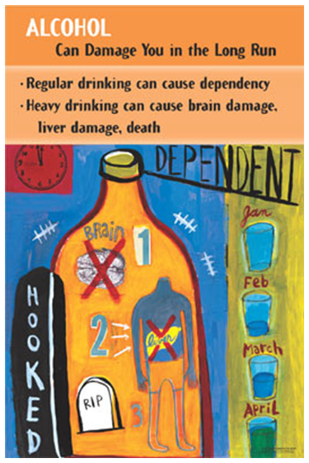
What Happens When People Drink?
Regular or Heavy Drinking

Slide 11
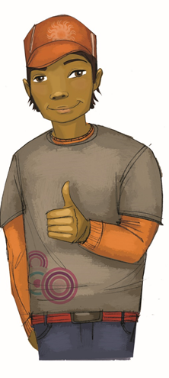
Alternatives to Drinking

Slide 12
The Alcohol Facts Game

Slide 13
Wrap-up
Today We:
Discussed how drinking can mask feelings but does not solve problems
Learned what happens can happen if someone drinks once, often, or a lot
Next Lesson We Will:
Look at how advertisers create pressure to use drugs and alcohol

