Slide 1
Core Lesson 2:
Consequences of Using Nicotine and Marijuana
How nicotine and marijuana affect people?
What happens when you use nicotine and marijuana?

Slide 2
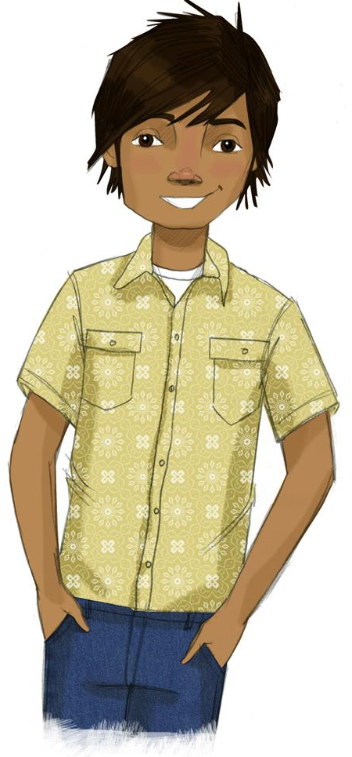
STUDENT GROUND RULES

Slide 3
TEACHER GROUND RULES
RESPECT ALL STUDENTS
I will listen carefully to what you have to say and treat all responses with respect.
INCLUSION
I will encourage all students to participate in the program's activities.
MAINTAIN CONFIDENTIALITY AND PRIVACY
I will keep things I hear in class private unless I learn that a rule, such as getting drunk at school, has been broken. As a teacher, I am required to report this.

Slide 4
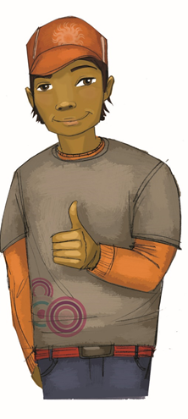
What Can Happen to You When You Use Nicotine
​ Any time ​ | ​ Regularly or a few drinks a week ​ | ​ Heavily or a lot at one time ​
​ ​ | ​ ​ ​ | ​ ​

Slide 5
Which of the Same Consequences Applies to Smokeless Tobacco?
​ Any time ​ | ​ Regularly or a few drinks a week ​ | ​ Heavily or a lot at one time ​
​ ​ | ​ ​ ​ | ​ ​

Slide 6
Which of the Same Consequences Applies to Vaping?
​ Any time ​ | ​ Regularly or a few drinks a week ​ | ​ Heavily or a lot at one time ​
​ ​ | ​ ​ ​ | ​ ​

Slide 7
What Can Happen to You When You Use Marijuana?
​ Any time ​ | ​ Regularly or a few drinks a week ​ | ​ Heavily or a lot at one time ​
​ ​ | ​ ​ ​ | ​ ​

Slide 8
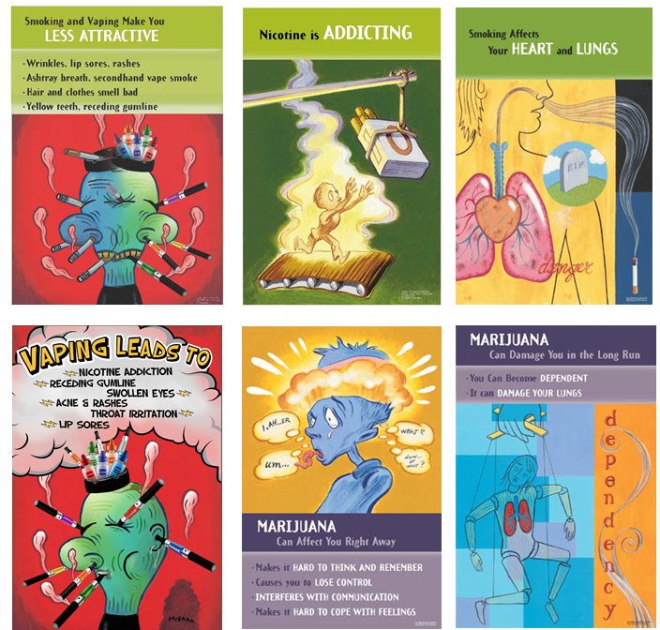
Review of Consequences

Slide 9
Video: “Pot, the Party Crasher”
Notes:
The Video - https://www.projectalert.com/videos

Slide 10
Wrap-up
Today, We:
Talked about the short-, medium-, and long-term effects of using nicotine and marijuana
Learned about the serious consequences of both
Next Lesson, We Will:
Talk about the consequences of using alcohol

