Slide 1
Core Lesson 11: Benefits of Not Using Drugs
Review what we have learned
Hear from high school students why they say "no" to drugs
Make a commitment to be substance free

Slide 2
STUDENT GROUND RULES

Slide 3
TEACHER GROUND RULES
RESPECT ALL STUDENTS
I will listen carefully to what you have to say and treat all responses with respect.
INCLUSION
I will encourage all students to participate in the program's activities.
MAINTAIN CONFIDENTIALITY AND PRIVACY
I will keep things I hear in class private unless I learn that a rule, such as getting drunk at school, has been broken. As a teacher, I am required to report this.

Slide 4
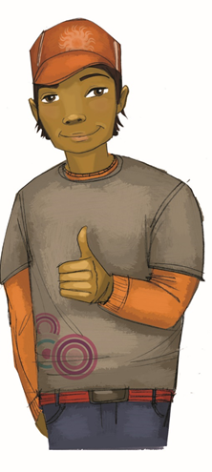
The Information Review Game
True or False: Teens who vape or smoke can’t have lip sores, throat irritation, yellow teeth, or smoker’s breath because they’re too young.

Slide 5
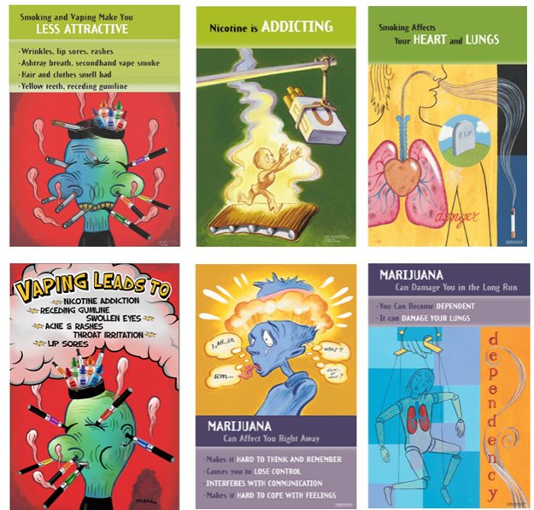
The Information Review Game
2. How does vaping or smoking affect your athletic performance?

Slide 6
The Information Review Game
3. An emotion is a feeling people have inside, like happiness or sadness. Name two emotions or feelings teens may have when they have a bad “high” using marijuana.

Slide 7
The Information Review Game
4. If you go to school “high,” there is a good possibility you will forget which of the following:
a) your birth date,
b) the answers to a school test?

Slide 8
The Information Review Game
5.When you drink alcohol, which of the following is affected:
a) your judgment,
b) your coordination
c) both

Slide 9
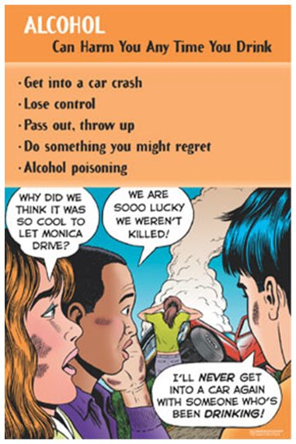
The Information Review Game
6. How many drinks can you have and still drive safely?

Slide 10
The Information Review Game
7. What does vaping and smoking do to your lungs each time you smoke?

Slide 11
The Information Review Game
8. True or False: It takes at least a year or two after you start vaping or smoking to become addicted to nicotine.

Slide 12
The Information Review Game
9. True or False:
Vaping is safer than
regular cigarettes.

Slide 13
The Information Review Game
10. True or False: Since marijuana is “natural,” it is safer than other drugs.

Slide 14
The Information Review Game
11. True or False:
People can become addicted
to marijuana.

Slide 15
The Information Review Game
12. If someone is addicted to alcohol, who are at least two people affected by this?

Slide 16
The Information Review Game
13. List two ways that alcohol can hurt you in the long run.

Slide 17
The Information Review Game
14. True or False: It’s OK to share prescription drugs between relatives or friends.

Slide 18
The Information Review Game
15. Which types of prescription drugs affects the brain’s messages about perception of painful feelings and pleasant feelings?

Slide 19
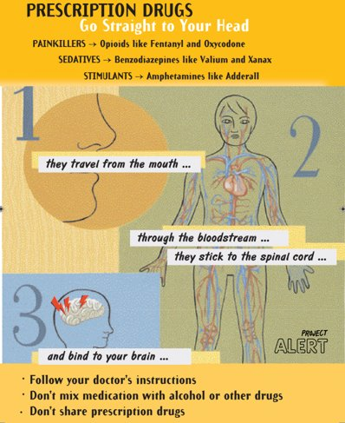
The Information Review Game
16. Fentanyl is up to how many times stronger than morphine?

Slide 20
Video: Saying ‘No” to Drugs
Notes:
https://www.projectalert.com/videos
Show and Discuss Video: Saying “No” to Drugs (8 min.)

Slide 21
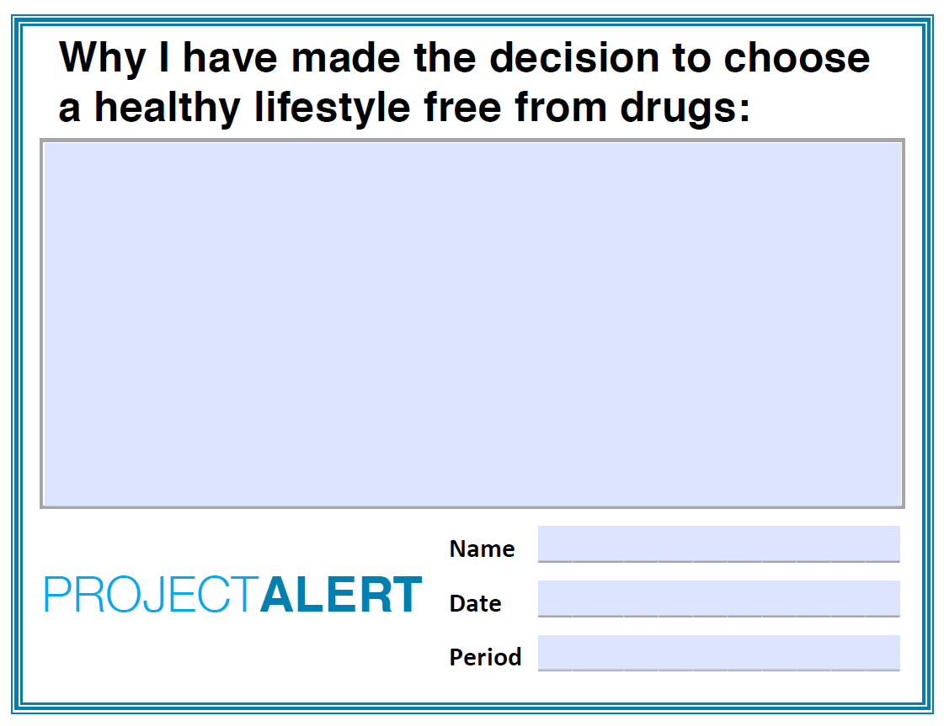
Choosing a Healthy Lifestyle Free From Drugs

Slide 22
Wrap-up

