Slide 1
Core Lesson 10: Smoking and Vaping Cessation
Why is it difficult to stop vaping and smoking?
How can you help someone quit?

Slide 2
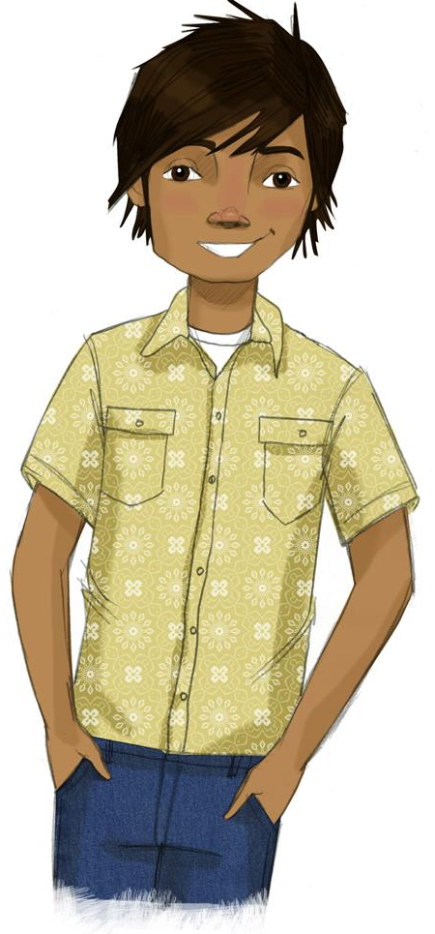
STUDENT GROUND RULES

Slide 3
TEACHER GROUND RULES
RESPECT ALL STUDENTS
I will listen carefully to what you have to say and treat all responses with respect.
INCLUSION
I will encourage all students to participate in the program's activities.
MAINTAIN CONFIDENTIALITY AND PRIVACY
I will keep things I hear in class private unless I learn that a rule, such as getting drunk at school, has been broken. As a teacher, I am required to report this.

Slide 4
Quitting Is Not Easy!
Why is it difficult to stop vaping and smoking?

Slide 5
Video: Clearing the Air
Notes:
https://www.projectalert.com/videos
Show and Discuss Video: Clearing the Air (14 min.)

Slide 6
Making Quitting Lists
What gets people to quit?
How do people quit?
What are the good things you get from quitting?
How can you help a friend or family member who is trying to quit?
Get into groups and choose a Recorder and a Reporter.

Slide 7
Making Changes
What are some habits you’d like to change?

Slide 8
Wrap-up
Today We:
Learned why it's so hard to quit smoking.
Thought about how we could help someone quit
Considered a change we want to make in our own lives
Next Lesson We Will:
Review what we have learned in Project ALERT!

