Slide 1
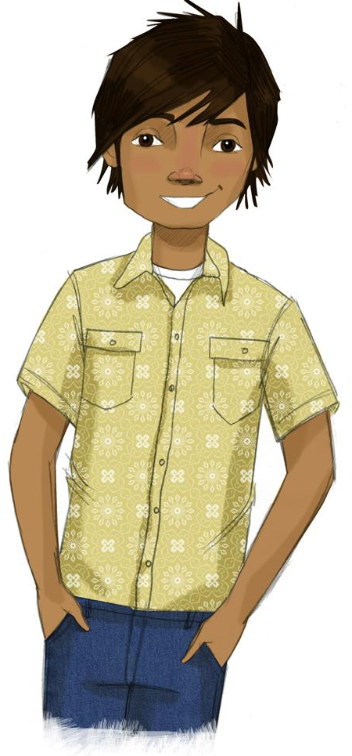
Lesson 1:
Introduction to Project ALERT
Why some people use drugs and why most people don’t?
How to recognize the pressures to use drugs?
How to resist these pressures?
Present
Share
FileEditViewInsertFormatSlideArrangeToolsAdd-onsHelpLast edit was 5 minutes ago
Nunito
Format options Animate
To enable screen reader support, press Ctrl+Alt+Z To learn about keyboard shortcuts, press Ctrl+slash
Notes:
All Google slides copyright 2023 by the RAND Corporation. All rights reserved.

Slide 2
STUDENT GROUND RULES

Slide 3
TEACHER GROUND RULES
RESPECT ALL STUDENTS
I will listen carefully to what you have to say and treat all responses with respect.
INCLUSION
I will encourage all students to participate in the program's activities.
MAINTAIN CONFIDENTIALITY AND PRIVACY
I will keep things I hear in class private unless I learn that a rule, such as getting drunk at school, has been broken. As a teacher, I am required to report this.

Slide 4
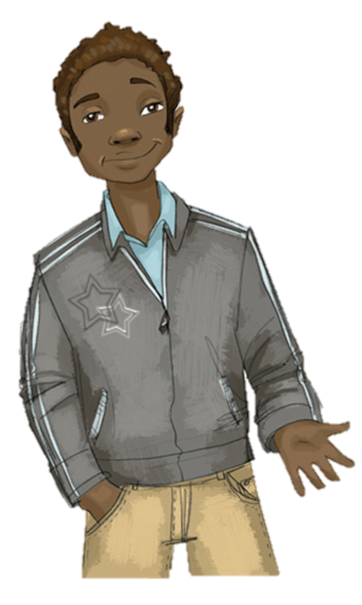
Reasons People Use
Group 1: Reasons Why People Might Use Nicotine
Group 2: Reasons Not to Use Nicotine
Group 3: Reasons Why People Might Use Marijuana
Group 4: Reasons Not to Use Marijuana

Slide 5
Reasons People Use
Group 1: Reasons Why People Might Use Nicotine

Slide 6
Reasons Not to Use
Group 2: Reasons Not to Use Nicotine

Slide 7
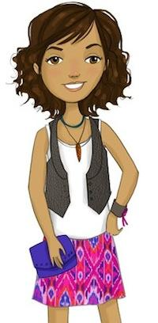
Reasons People Use
Group 3: Reasons Why People Might Use Marijuana

Slide 8
Reasons Not to Use
Group 4: Reasons Not to Use Marijuana

Slide 9
Let’s Compare
Marijuana and Alcohol

Slide 10
Video: Let’s Talk About Marijuana
Notes:
The Video - https://www.projectalert.com/videos

Slide 11
Wrap-up
Today We:
Set ground rules
Thought about reasons why and why not to try nicotine and marijuana
Learned there are similar reasons to resist both substances
Next Lesson We Will:
Talk about what really happens when someone smokes or vapes nicotine or marijuana

