Slide 1
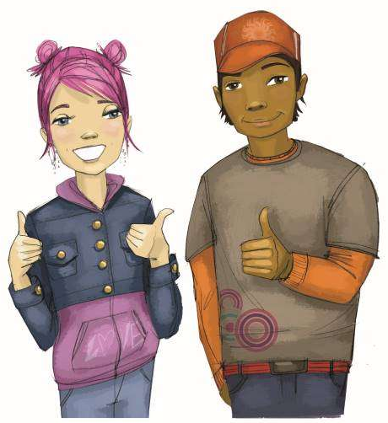
Booster Lesson 3: Benefits of Resisting Drugs
Practice saying "no"
Remember the benefits of not using substances

Slide 2
TEACHER GROUND RULES
RESPECT ALL STUDENTS
I will listen carefully to what you have to say and treat all responses with respect.
INCLUSION
I will encourage all students to participate in the program's activities.
MAINTAIN CONFIDENTIALITY AND PRIVACY
I will keep things I hear in class private unless I learn that a rule, such as getting drunk at school, has been broken. As a teacher, I am required to report this.

Slide 3
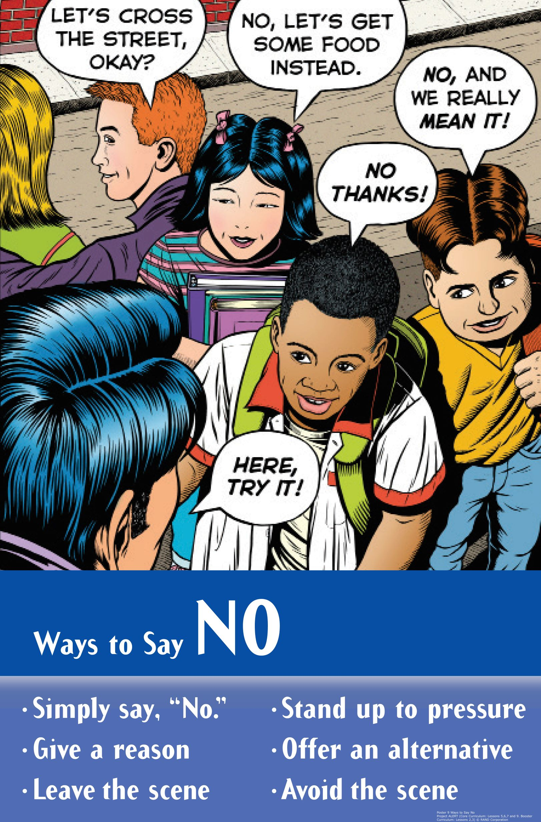
Direct Pressures

Slide 4
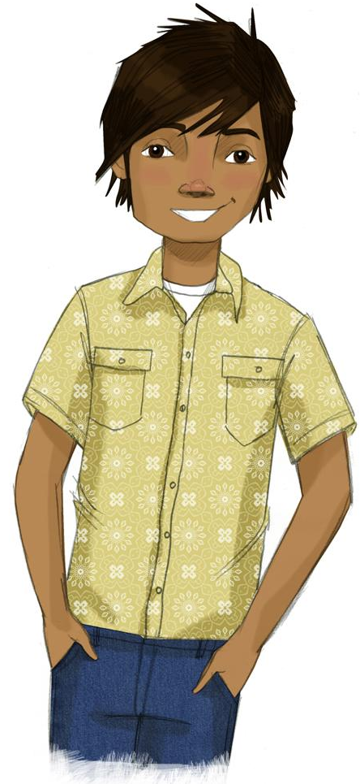
Benefits of Resistance

Slide 5
Video: Resisting Peer Pressure
Notes:
https://www.projectalert.com/videos
Show and Discuss Video: Resisting Peer Pressure (12 min.)

Slide 6
Benefits of Not Using Drugs
School and Sports | Health and Appearance | How You Act or Feel About Yourself

Slide 7
Wrap-up

