Slide 1
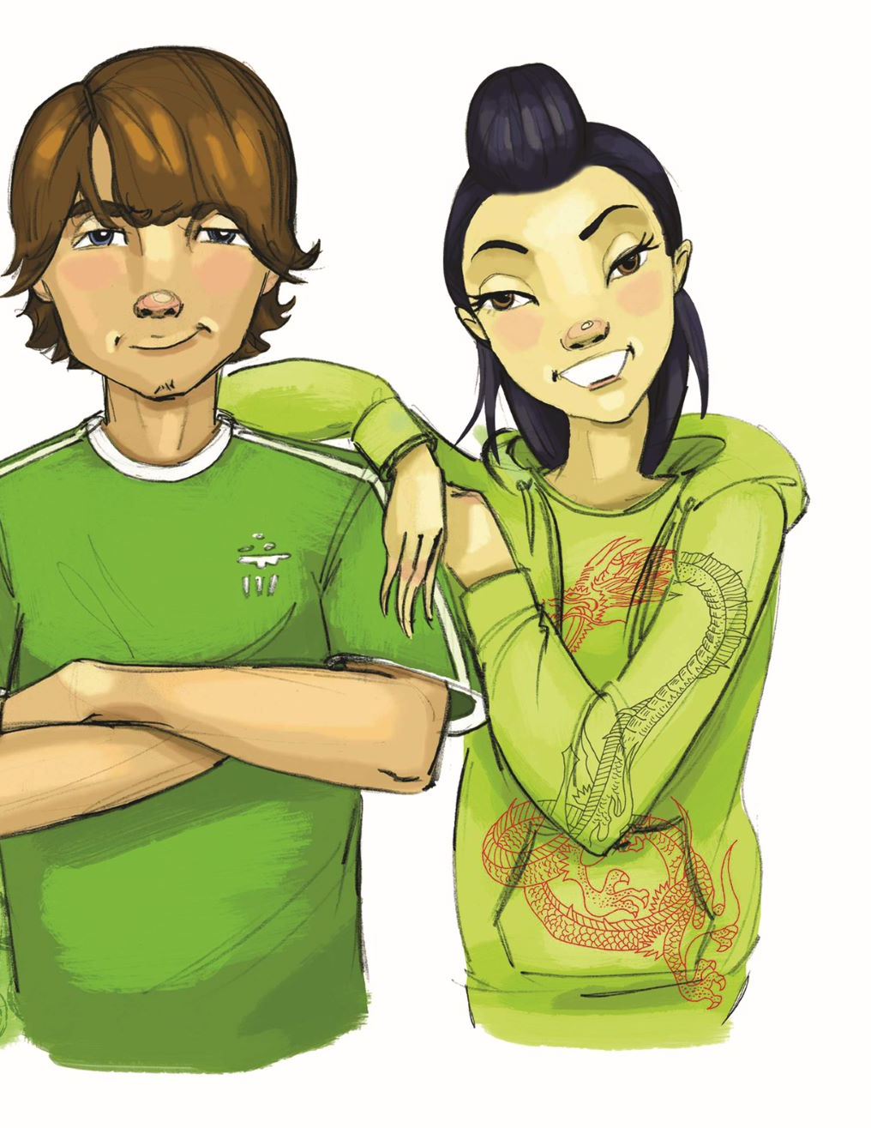
Booster Lesson 2: Resisting External and Internal Pressures
What are internal and external pressures to use drugs?
How can we say "no" to drug use?

Slide 2
TEACHER GROUND RULES
RESPECT ALL STUDENTS
I will listen carefully to what you have to say and treat all responses with respect.
INCLUSION
I will encourage all students to participate in the program's activities.
MAINTAIN CONFIDENTIALITY AND PRIVACY
I will keep things I hear in class private unless I learn that a rule, such as getting drunk at school, has been broken. As a teacher, I am required to report this.

Slide 3
Video: Paul’s Fix
Notes:
https://www.projectalert.com/videos
Show Partial Video: Paul’s Fix (Problem) (5 min.)

Slide 4
Paul’s Fix:
Why It Is Hard/Not Hard to Say “No.”
​​ Hard​​ | ​​ Not Hard​
​​ ​​ | ​​ ​​ ​​

Slide 5
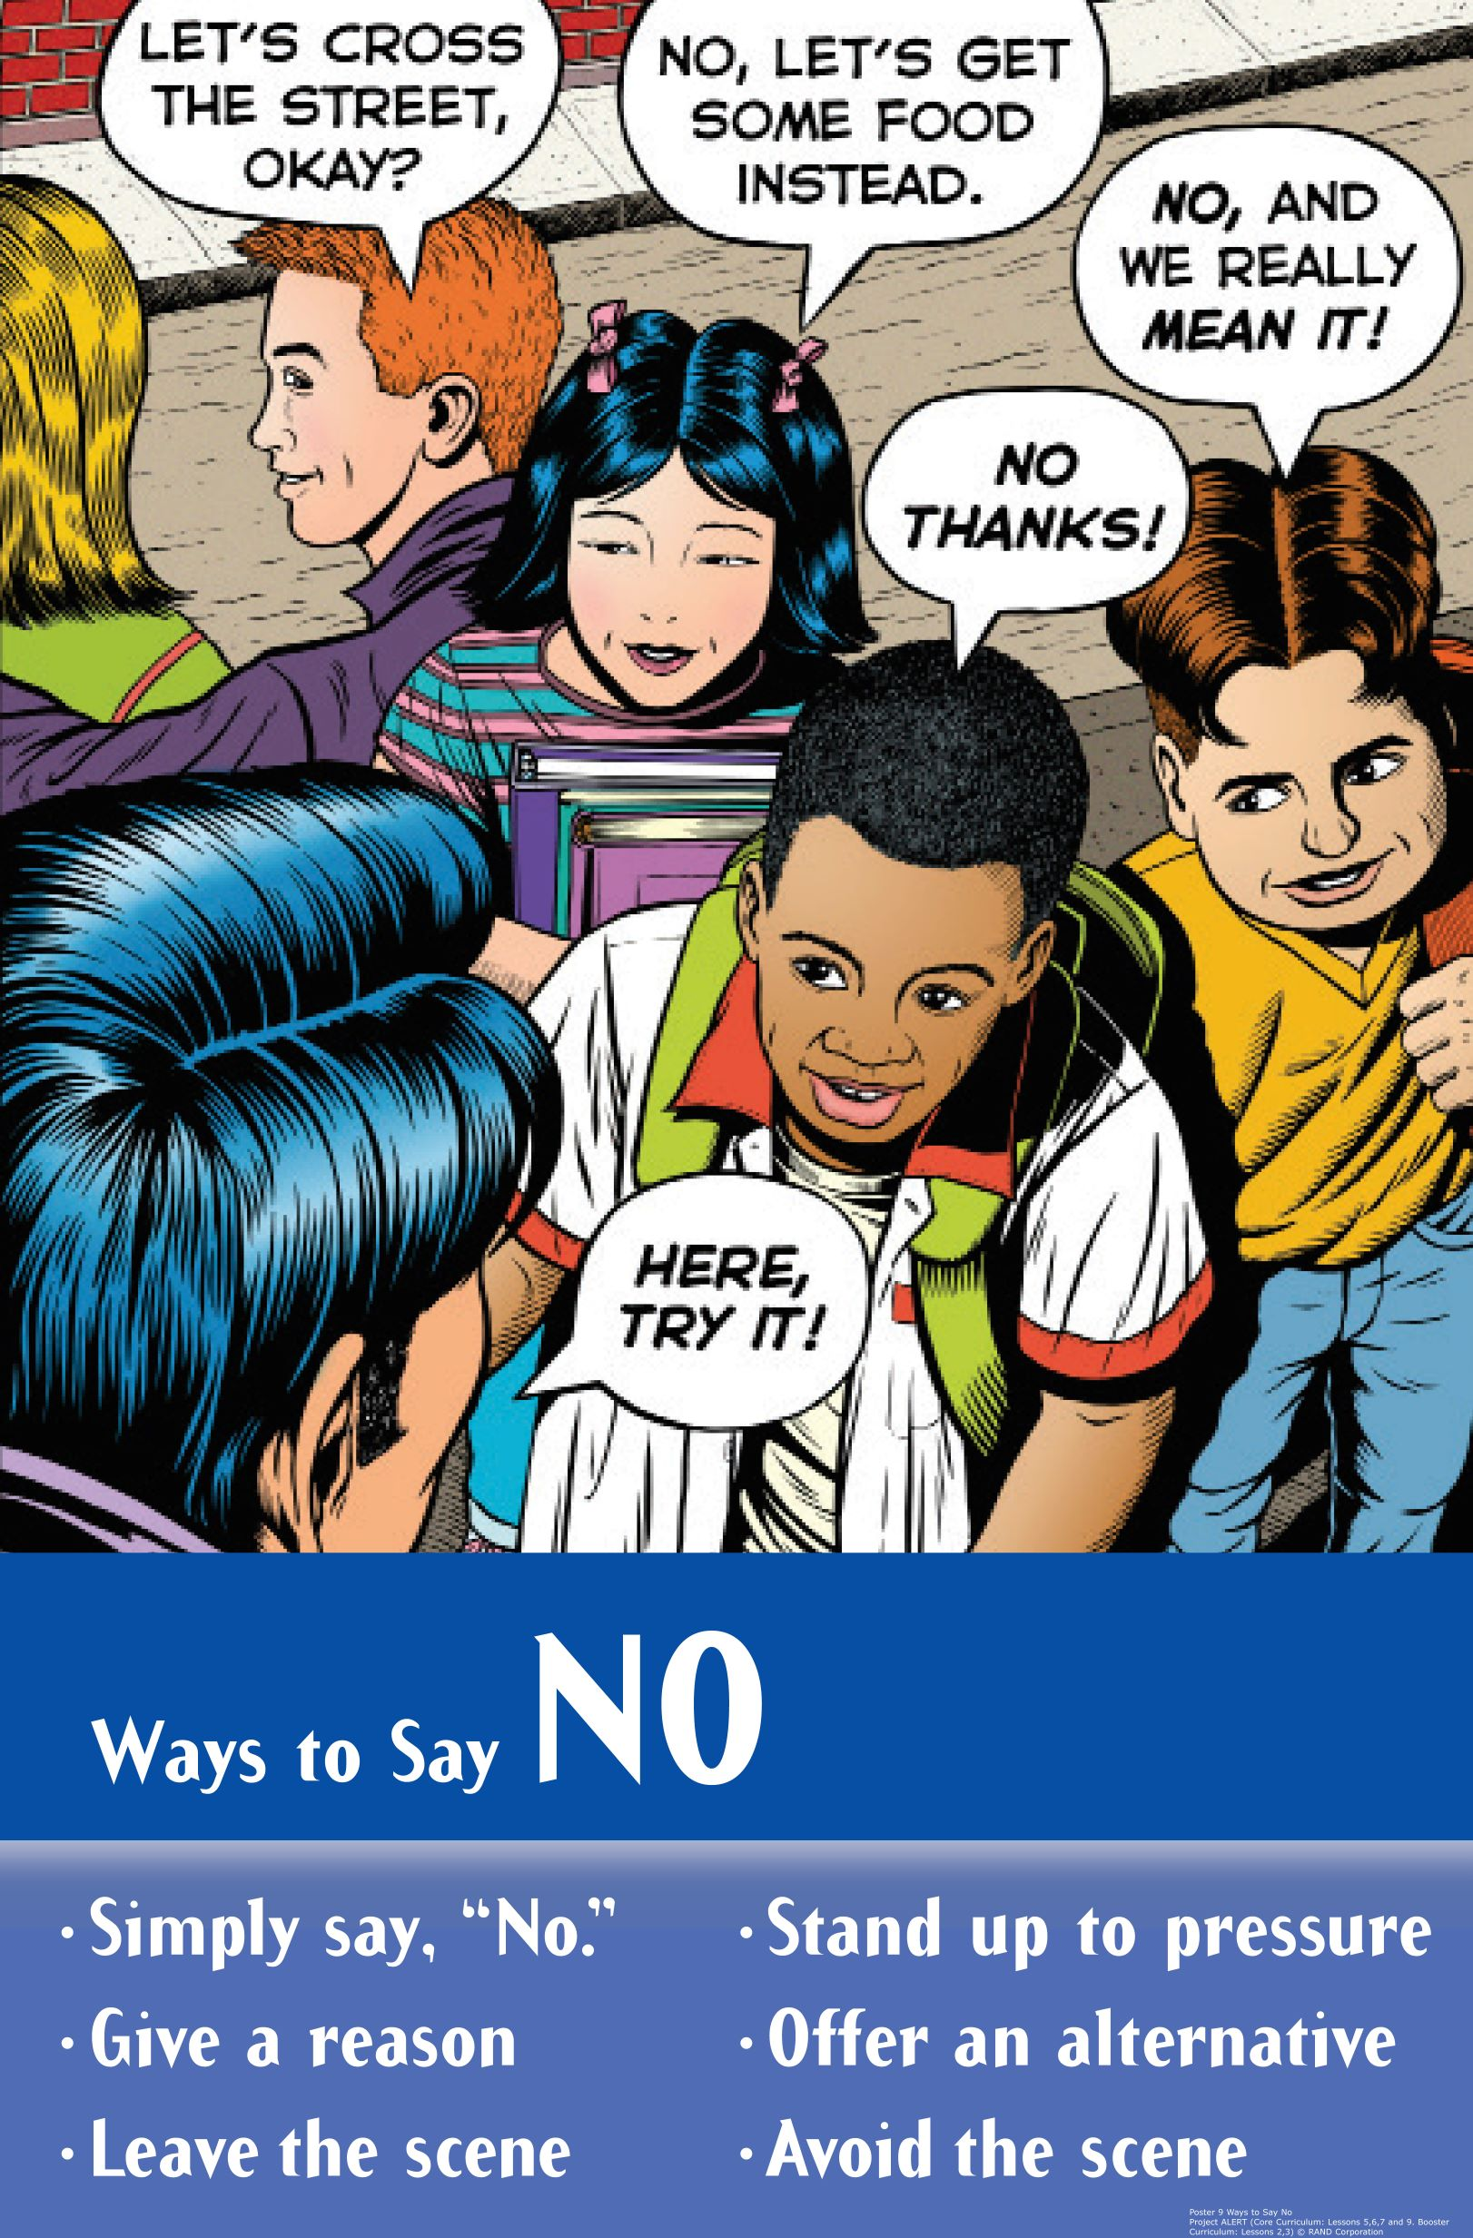
Video: Paul’s Fix and How to Respond to Pressure

Slide 6
Video: Paul’s Solution
Notes:
https://www.projectalert.com/videos
Show Partial Video: Paul’s Fix (Solution)

Slide 7
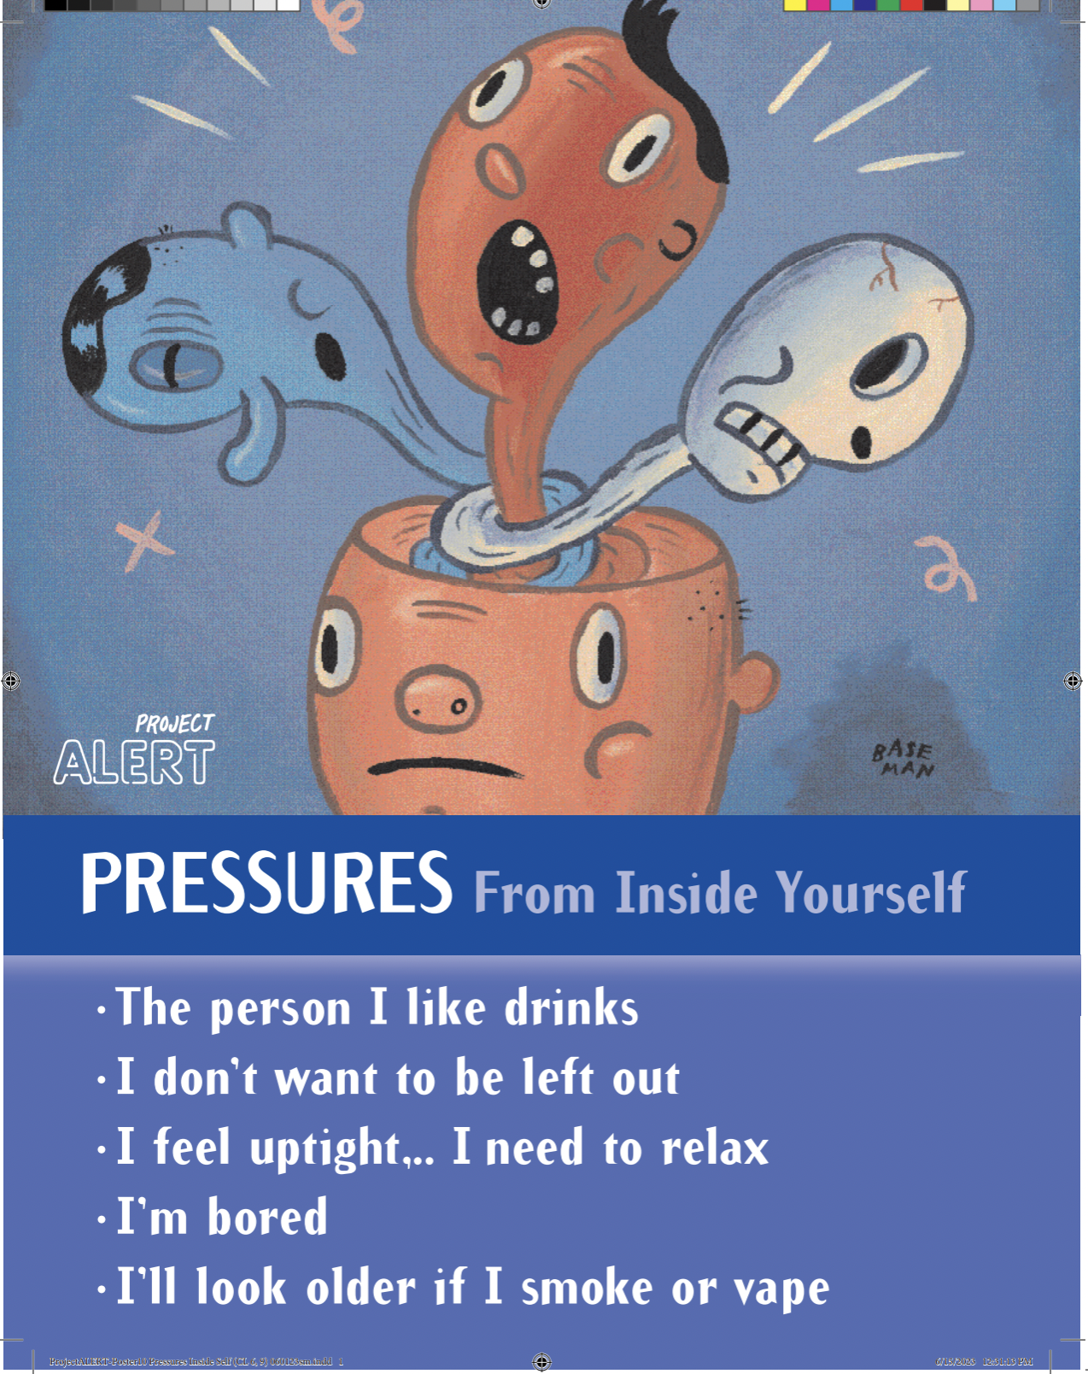
Internal Pressure

Slide 8
Skits: Saying "No" to Internal Pressure
Group Roles:
Director: Assign parts & get group to work together
Actors: Perform the roles of the characters in the skit
Recorder: Write down the final version of the script

Slide 9
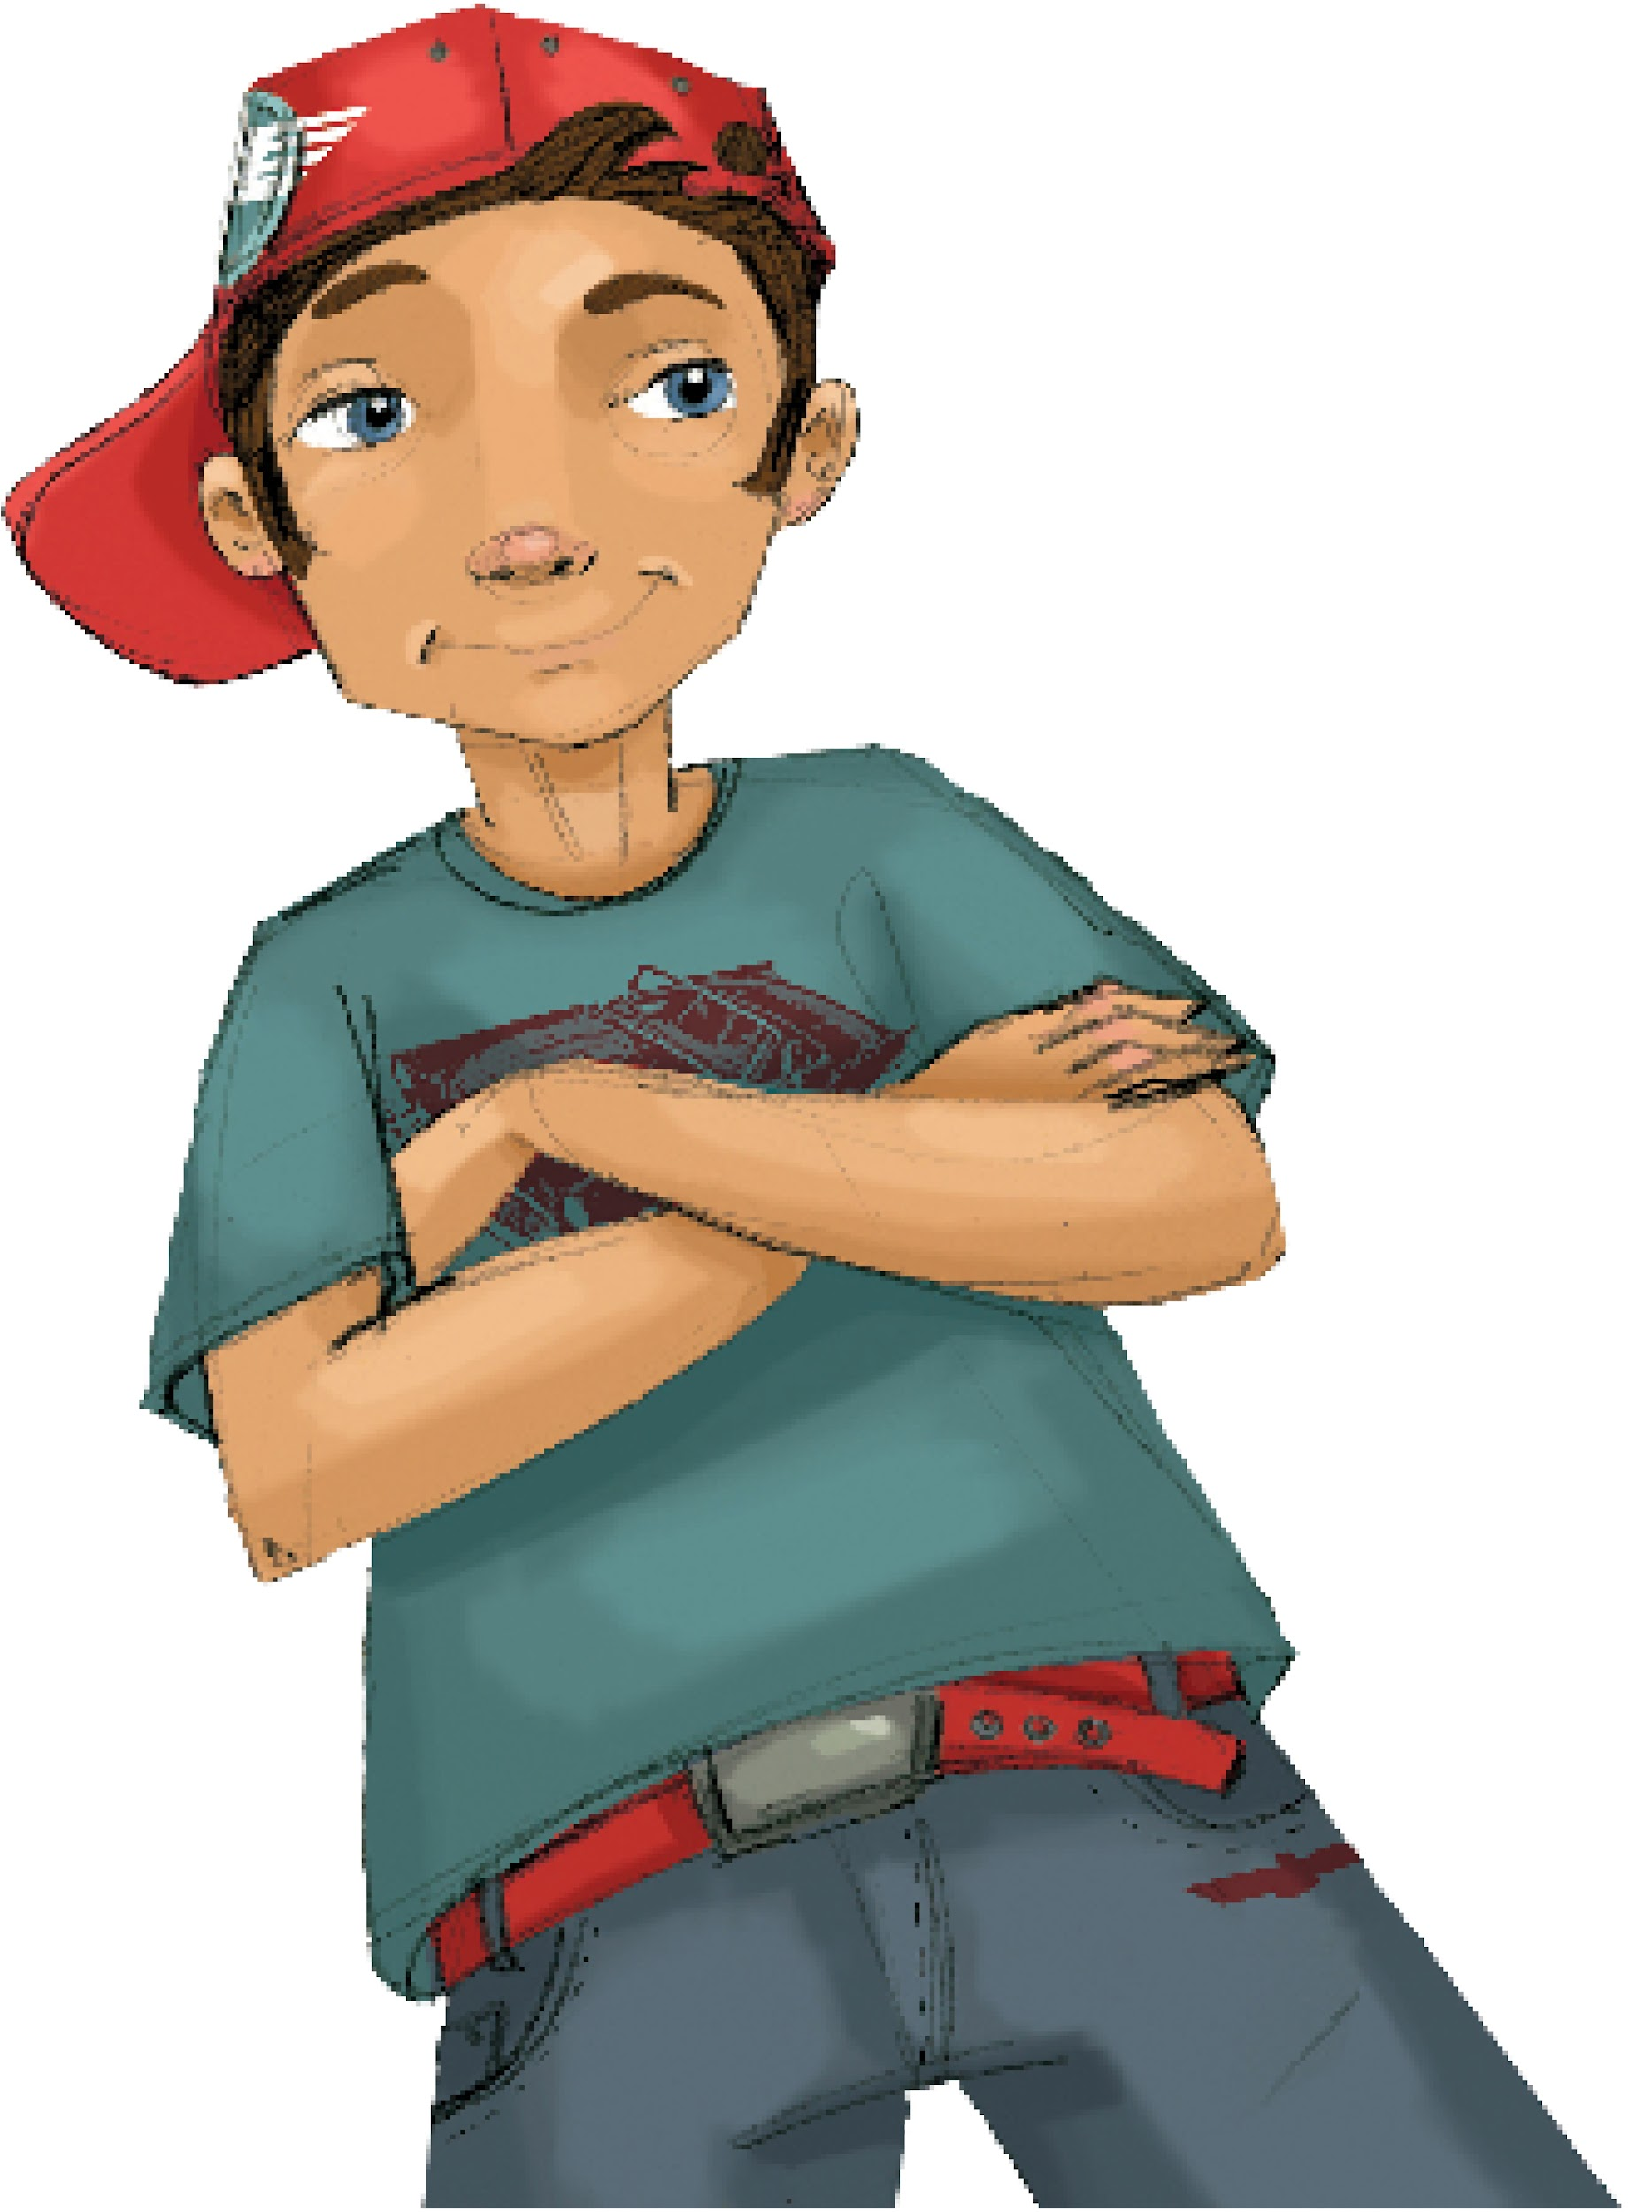
Saying "No" to Internal Pressure Act Out Skits
Activity Expectations
Speak up
Face the class
Introduce Characters
Attentive Audience

Slide 10
Wrap-up
Today We:
Talked about ways to say "no" to pressure.
Created skits with different approaches to saying "no".
Next Lesson We Will:
Talk about what really happens when someone smokes or vapes nicotine or marijuana

