Slide 1
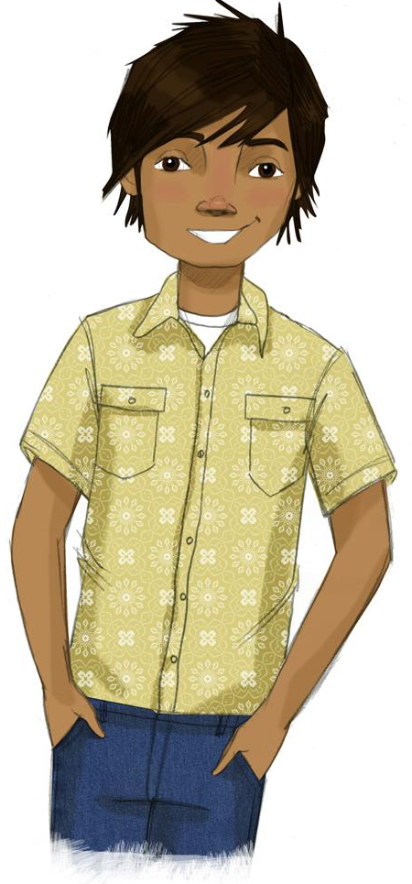
Booster Lesson 1:
Motivating Resistance to Drugs
What are the consequences of drug use?
How to recognize the pressures to use drugs?
How to resist these pressures?
Present
Share
FileEditViewInsertFormatSlideArrangeToolsAdd-onsHelpLast edit was 5 minutes ago
Nunito
Format options Animate
To enable screen reader support, press Ctrl+Alt+Z To learn about keyboard shortcuts, press Ctrl+slash
Notes:
All Google slides copyright 2023 by the RAND Corporation. All rights reserved.

Slide 2
TEACHER GROUND RULES
RESPECT ALL STUDENTS
I will listen carefully to what you have to say and treat all responses with respect.
INCLUSION
I will encourage all students to participate in the program's activities.
MAINTAIN CONFIDENTIALITY AND PRIVACY
I will keep things I hear in class private unless I learn that a rule, such as getting drunk at school, has been broken. As a teacher, I am required to report this.

Slide 3
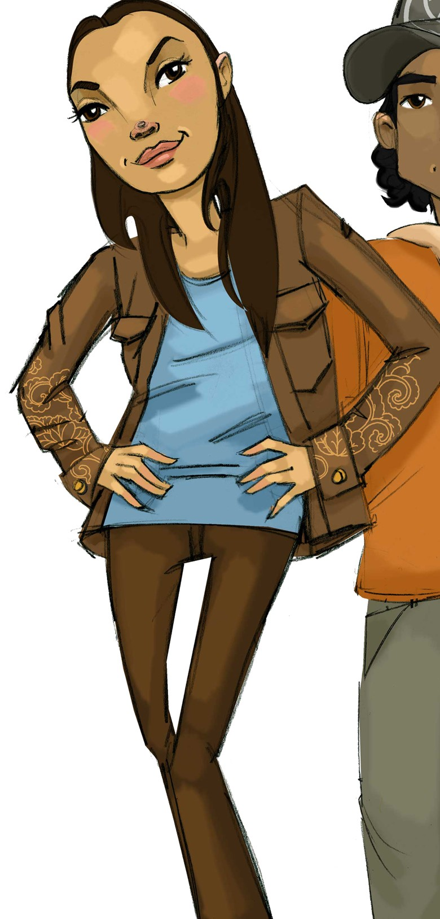
Consequences of Using Nicotine, Marijuana and Alcohol
Group 1: Consequences of using nicotine
Group 2: Consequences of using marijuana
Group 3: Consequences of using alcohol

Slide 4
Consequences of Using Nicotine, Marijuana and Alcohol
Group 1: Consequences of using nicotine

Slide 5
Consequences of Using Nicotine, Marijuana and Alcohol
Group 2: Consequences of using marijuana

Slide 6
Consequences of Using Nicotine, Marijuana and Alcohol
Group 3: Consequences of using alcohol

Slide 7
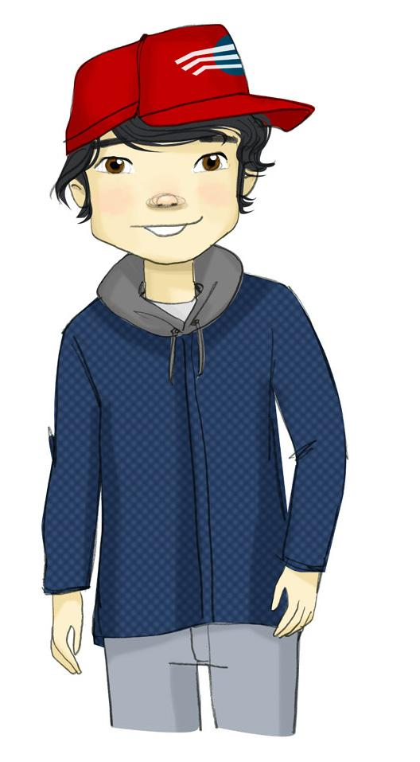
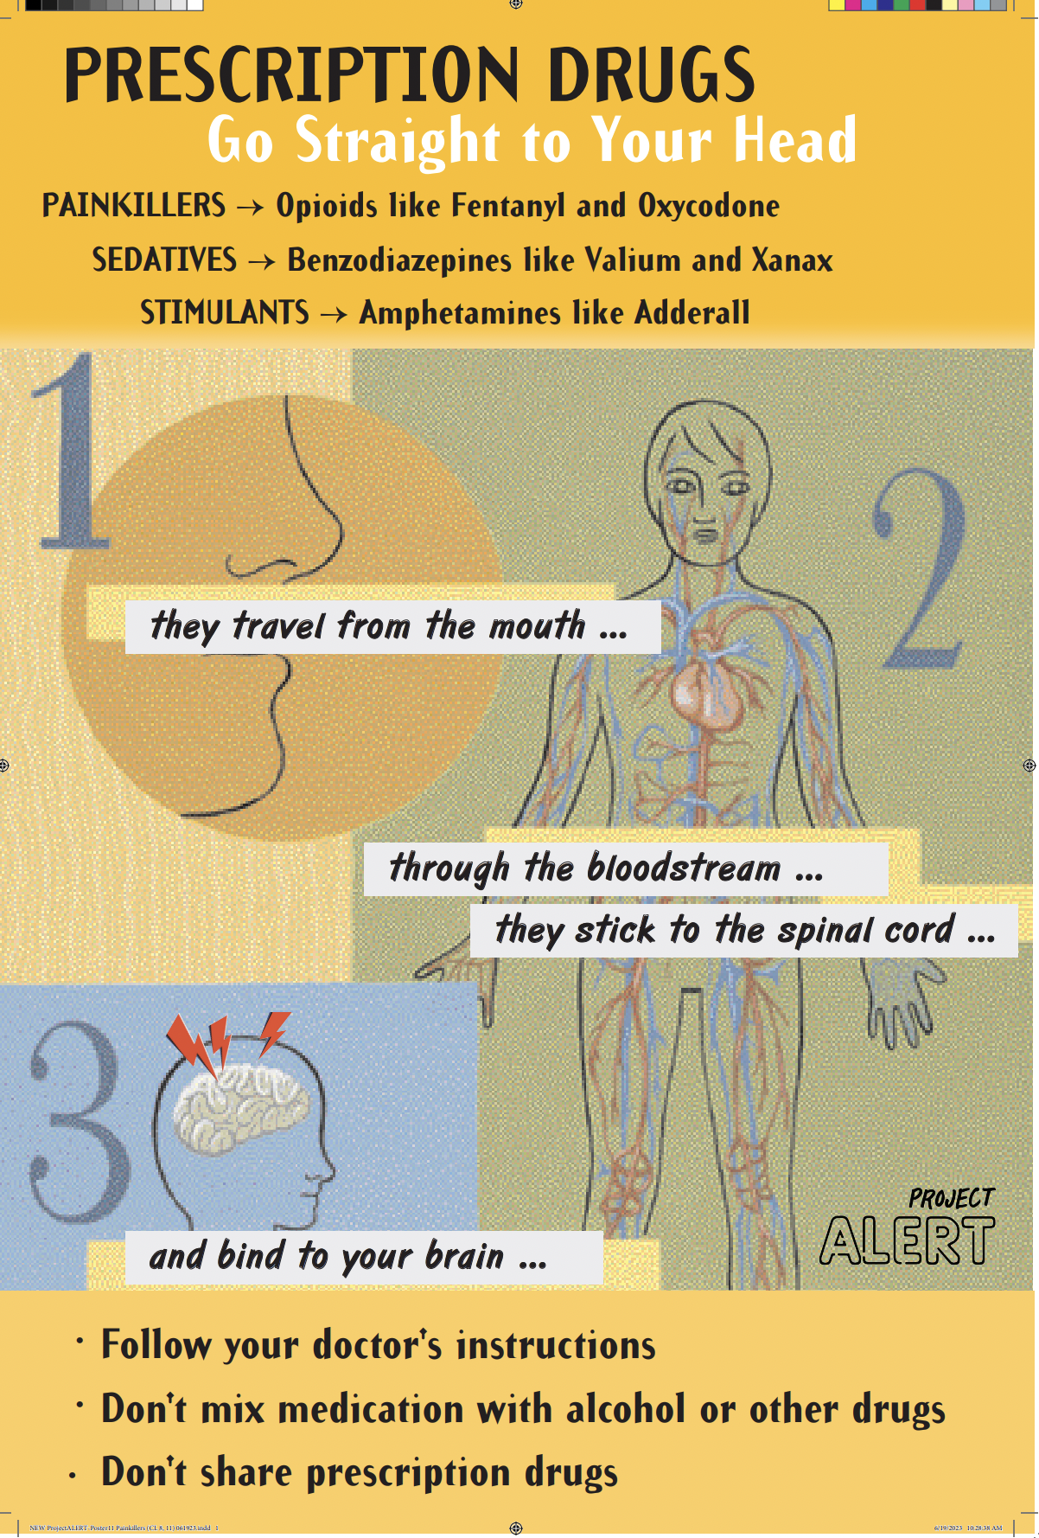
Consequences of Misusing Prescription Drugs

Slide 8
Prevalence of Substance Use

Slide 9
Where Does Pressure to Use Drugs Come From?

Slide 10
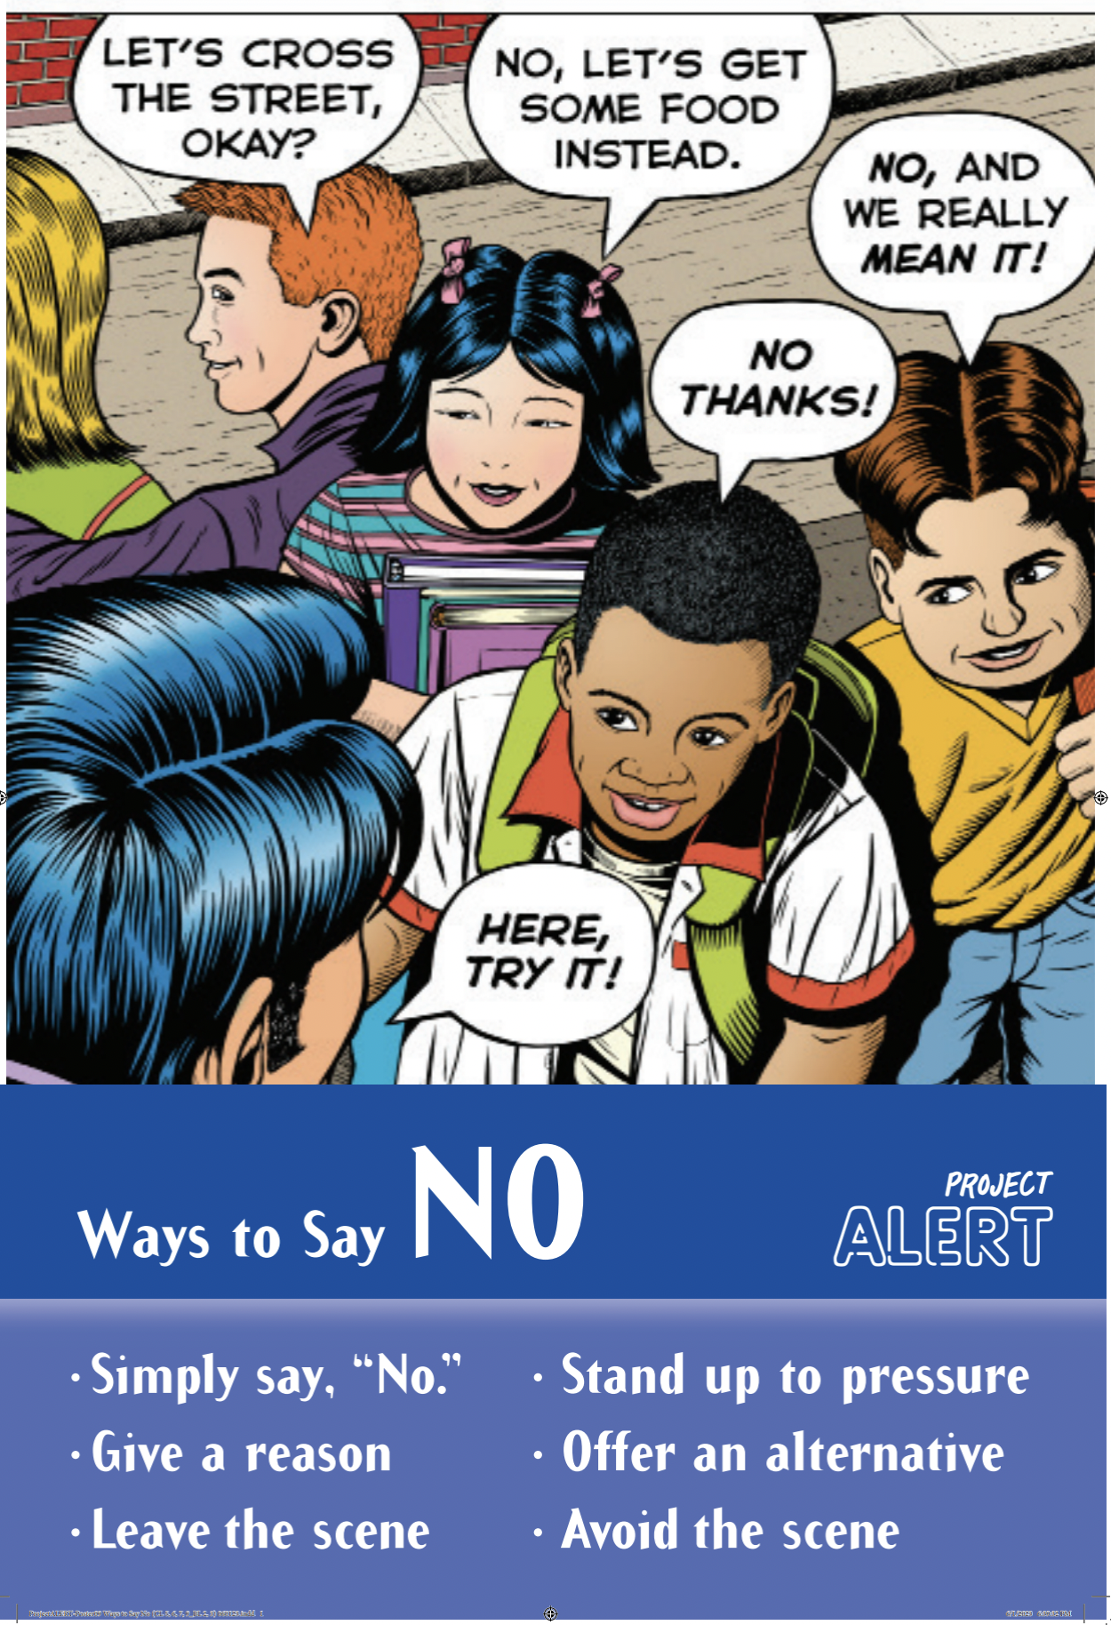
Resisting Pressure Lines Game

Slide 11
Wrap-up
Today We:
Thought about reasons to avoid drug use
Learned most teens are not using drugs
Practiced saying "no"
Next Lesson We Will:
Practice saying "no"

